Slide 1
Graduate Students as Mentors in Research to Enhance Undergraduate Performance
Kevin B. Miles
kbmiles@wayne.edu
The Office for Teaching and Learning
otl@wayne.edu
313-577-6574
www.otl.wayne.edu

Slide 2
Expected Outcomes
After this presentation the audience will be able to:
Recognize sound (and active) mentoring practices
Review examples of good mentoring practices from studies conducted in the STEM fields (academic, public and private sector)
Design mentoring practices into their teaching (for practical/lab courses) or research

Slide 3
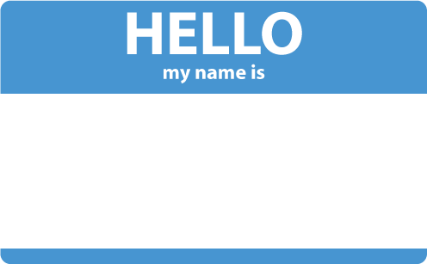
Introductions
Tell us who you are!
Turn to a partner and introduce yourself (e.g., name, college and role)
Discuss what actions are involved in mentoring.
Active vs. passive

Slide 4
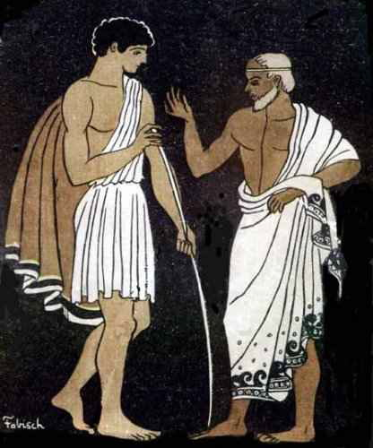
Mentoring Background
Mentoring:
Homer’s Odyssey, “Mentor”
Teacher and overseer to Odysseus’ son
“Mentor” as an English term:
Trusted advisor
Teacher
Wise person
Traditionally, university faculty have acted as mentors to students
Increasing class sizes
More demands on faculty time
(Shea, 1997)

Slide 5
Mentoring Definition
“…the essential attributes of: a process; a supportive relationship; a helping process; a teaching-learning process; a reflective process; a career development process; a formalised [sic] process and a role constructed by or for a mentor.”
(Roberts, 2000, p. 162)

Slide 6
Mentoring Definition
“…the essential attributes of: a process; a supportive relationship; a helping process; a teaching-learning process; a reflective process; a career development process; a formalised [sic] process and a role constructed by or for a mentor.”
(Roberts, 2000, p. 162)

Slide 7
Mentoring Definition
“…the essential attributes of: a process; a supportive relationship; a helping process; a teaching-learning process; a reflective process; a career development process; a formalised [sic] process and a role constructed by or for a mentor.”
Graduate students are well positioned for these attributes:
Typically closer age to undergrads
“In the field/lab” instead of “in the office”
Obligations place them in proximity to undergrads
(Roberts, 2000, p. 162)

Slide 8
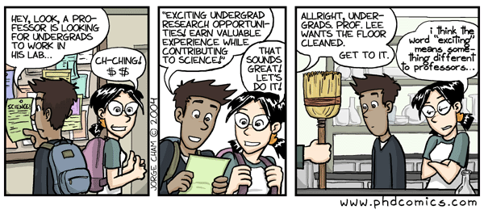
Mentor-Mentee Relationship
Who here is in a “mentoring role”?
Share some examples

Slide 9
Evidence: Mentoring for Clear Career Plans
Mentoring undergraduates to improve career goals:
Lunsford (2011) examined interview records from 128 academically talented students who partnered with a faculty mentor for 6 semesters.
Interviews were analyzed for:
Quality of relationship with the mentor
Career plan or outlook of career opportunities in field of study
(Lunsford, 2011)

Slide 10
Evidence: Mentoring for Clear Career Plans
(Lunsford, 2011)

Slide 11
Evidence: Positive Outcomes of Mentoring
Positive outcomes from mentoring study:
Enrolled undergraduate students in an Entering Research course
Faculty mentor responsibilities:
One-on-one meetings
Guided discussions of research, future careers
Control group = undergraduate researchers not enrolled in the Entering Research course.
(Balster et al., 2010)

Slide 12
Evidence: Positive Outcomes of Mentoring
Results from enhanced mentoring:
Entering Research students gained:
More lab skills
Increased confidence
Better understanding of the links between coursework and research
Compared to control
(Balster et al., 2010)

Slide 13
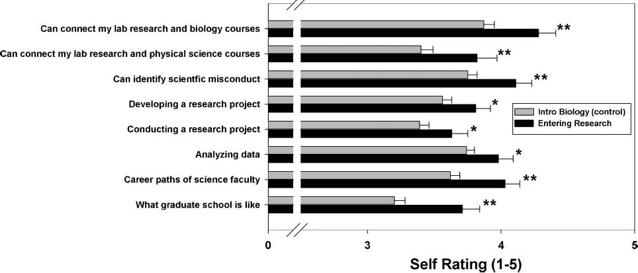
Evidence: Positive Outcomes of Mentoring
Results from enhanced mentoring:
(Balster et al., 2010)

Slide 14
Evidence: Outcomes from Lack of Mentoring
Study on effects from a lack of mentoring:
Undergraduate students in various co-op and internship positions were interviewed.
Co-ops were either government or private industry
Interviews involved surveys regarding:
Communication with coworkers
Self-assessment of company knowledge
Awareness of future prospects in company/field.
(Fifolt & Searby, 2010)

Slide 15
Evidence: Outcomes from Lack of Mentoring
Results:
Students with supervisors who did not adequately set aside time felt:
Confused
Unproductive
Lack of communication with the rest of the workforce.
(Fifolt & Searby, 2010)

Slide 16
Conclusion
Mentoring significantly improves undergraduate performance
Clear career plans prior to graduation
Better understanding of practical applications of coursework
Improved communication with colleagues
Graduate students could be useful stand-ins for faculty in process
Grad students are typically closer in age to undergrads
Closer contact with undergrads due to nature of work
Graduate students receive training as future faculty

Slide 17
Reflection
Discuss with a partner:
How can you use these strategies to improve student-mentor relationships in your classroom or lab?

Slide 18
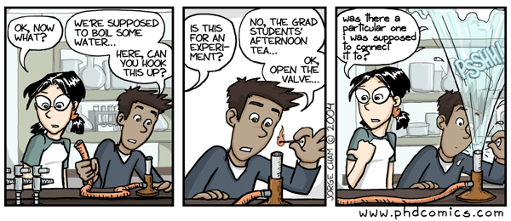
Questions or Comments

Slide 19
References
Balster, N., Pfund, C., Rediske, R., & Branchaw, J. (2010). Entering Research: A Course That Creates Community and Structure for Beginning Undergraduate Researchers in the STEM Disciplines. Cbe-Life Sciences Education, 9(2), 108-118. doi: DOI 10.1187/cbe.09-10-0073
Fifolt, M & Searby, L. (2010) Mentoring in Cooperative Education and Internships: Preparing Proteges for STEM Professions. Journal of STEM Education, 11 (1&2), 17-26.
Lunsford LG. Psychology of Mentoring: The Case of Talented College Students. Journal of Advanced Academics. 2011;22:474-98.
Roberts, A. (2000), “Mentoring revisited: a phenomenological reading of the literature”, Mentoring & Tutoring, Vol. 8 No. 2, pp. 162
Shea, Gordon F. (1997) Mentoring (Rev. Ed.). Menlo Park, CA: Crisp Publications

