Slide 1
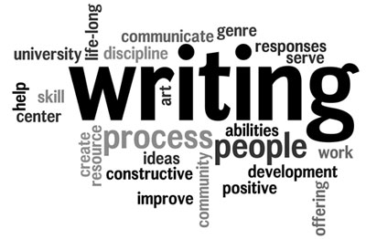

Slide 2
“I’m Going to be an Author?” Writing Instruction using Project- Based Learning
Randy Hamelin
Heather Greene

Slide 3
Project-Based Learning
Project-based learning is an experiential approach to learning. The objective is to provide a platform for individuals to build knowledge and skills through the development of creative solutions to challenging questions.

Slide 4
Project-Based Learning
Project-based learning can be a useful tool in the classroom to motivate students towards a directed goal, while simultaneously achieving the academic requirements of the course.

Slide 5
Project Examples
Funding Reports for non-for-profit organizations.
Robotics (skills competition)
Awareness Campaigns (community based ed., health fair)
Woodworking (construct rooms, reno, house projects.
Create and launch a Smartphone App
Social Media campaign for local businesses
http://bie.org/for/teachers

Slide 6
COURSE OBJECTIVES
The reading process
Punctuation, grammar and writing mechanics
The writing process
Writing a thesis statement
Paragraph structure
Developing and writing different types of essays
Writing an APA formatted research paper
Peer review and editing for grammar and spelling
Preventing plagiarism
Journal/blog

Slide 7
Project-Based Group Assignment
Form a 5 member group.
Choose a type of book that you would like to write.
In your group brainstorm ideas and develop a working outline.
At the beginning of each class we lecture on a specific topic that will be related to the next step in the writing process of their manuscript.
Each class, students work in their groups to develop their manuscript.

Slide 8
Project-Based Group Assignment
Lecture examples:
After learning how to create a thesis– the group develops a thesis for their book.
After learning how to create an abstract– the abstract becomes the back cover of the book.
The research for the individual APA essay is used to develop the characters, structure and style of their book.

Slide 9
Creative Options
Newspaper/Magazine
Create a weekly newspaper. Your newspaper will have all the sections that a daily newspaper includes.
(ie. cover story, current local events, sports, global events, funny pages, word-search).
Individual research assignment: choose a research midterm essay topic that is related to an article that your newspaper has covered.

Slide 10
Creative Options
Eat-Pray-Love Novel
If you have not watched the movie or read the novel "Eat Pray Love", by Elizabeth Gilbert, please do so before starting this project. It is a story about a woman's journey of self discovery. Her journey takes her to Italy for pizza, India for prayer, and Bali for love. Your group will be responsible for creating a character that will embark on a journey to different lands and discover something different about themselves in each destination. Each member will choose a different location to research and take the main character through. Each group member will be creating a chapter that will be put together as a whole.
Individual research assignment: your research midterm essay will be the same topic as the country you are researching for your character. Your research will be specific to what your character discovers in that country that is meaningful to them
(ie. food, dance, music, spirituality love etc.)

Slide 11
Creative Options
Children's book
Create a children's book that relates to an issue that you may come across in your field of study (ie. bullying, discrimination, divorce, disability, etc.). You are responsible for the written component of the book and the illustrations.
Individual research assignment: Your research midterm essay topic will be the same as the main theme in your book or a famous children's author.
(ie. Robert Munch, Louisa May Alcott, Norman Bridwell, EB White, Lucy Maud Montgomery, Dr. Seuss).

Slide 12
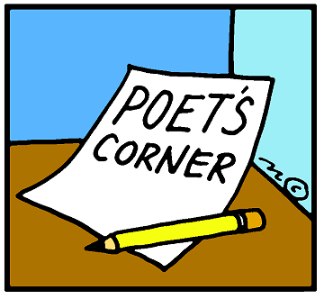
Creative Options
Book of Poetry
Each member of your group will be responsible for coming up with a collection of poems. Each member of the group will submit one poem each week. The poems can be of any variety.
(ie. acrostic, blank verse, sonnet, limerick, narrative, haiku)
Individual research assignment: your research midterm essay topic will be to write an essay on a famous poet.
(ie. Shakespeare, Wordsworth, William Blake, E.E. Cummings).

Slide 13
Creative Options
Book of Short Stories
As a group you will be collaborating to develop a book of short stories. Your book can be made up of fictional stories, non-fictional stories, or a combination of both.
Individual research assignment: your research midterm essay topic will be to write an essay on a famous deceased author of your choice.
(ie. Charles Dickens, George Orwell, Charlotte Perkins- Gilman, Mark Twain, Jack London, Emily Dickinson, Charlotte Bronte).

Slide 14
Forming Groups
Head to the station that best matches your reading interests. **handout**
Our objective for the activity is to:
Brainstorm a topic
Determine basic setting, characters, and plot
Formulate a thesis
Formulate an abstract
Brainstorm local publishing resources

Slide 15
Publishing Brainstorm
Public Library
UPS
Online photobook (Shutterfly, Blurb)
Indigo, Chapters, Amazon, Barnes and Noble
Printing Presses (Black Moss Press, Biblioasis, Queen Bee Publishing Company, Lexicon Publishing Group)
Binding Companies (Staples, Office Max)

Slide 16
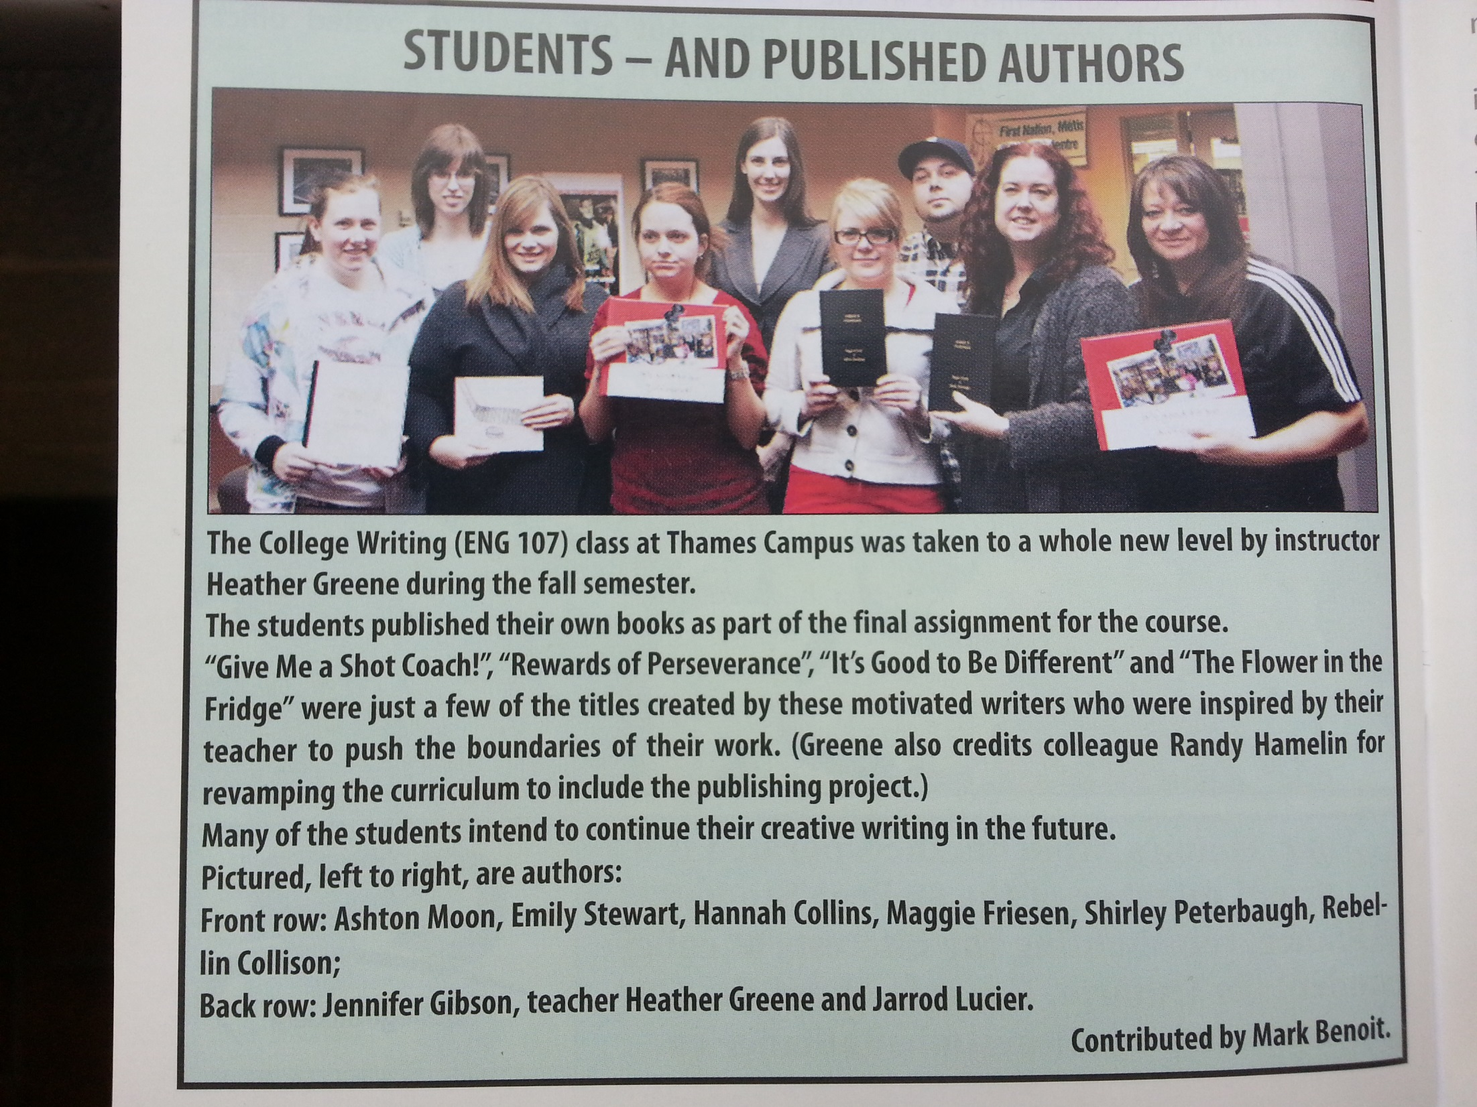

Slide 17
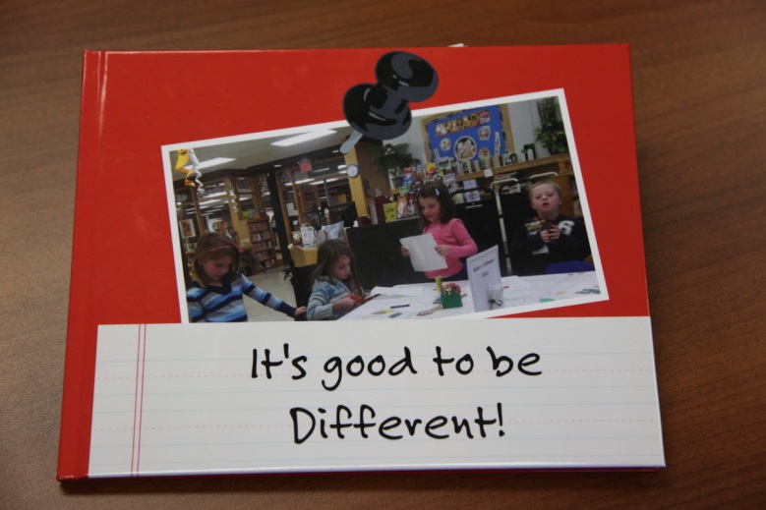
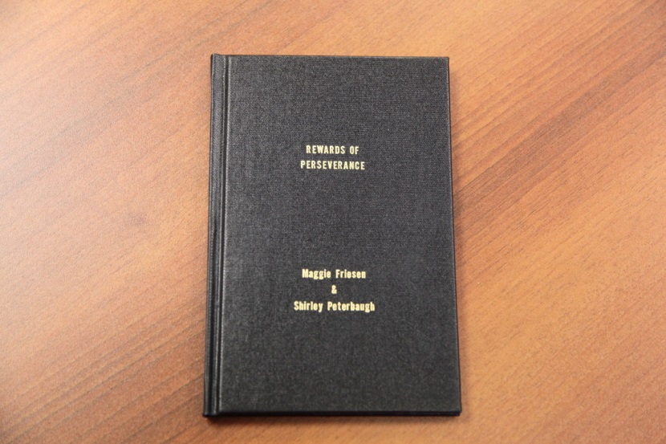
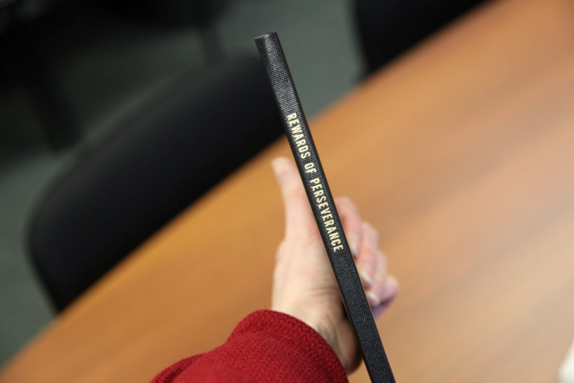
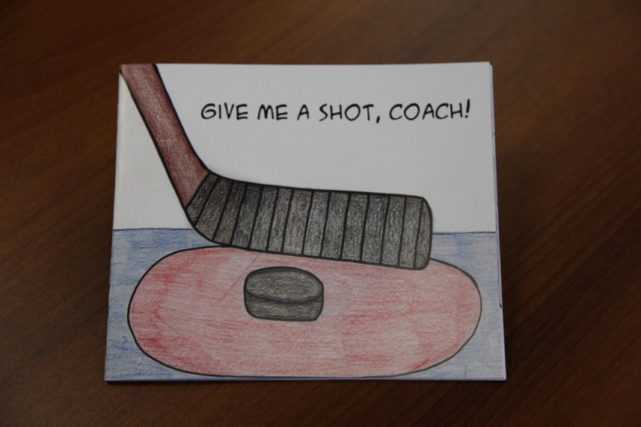
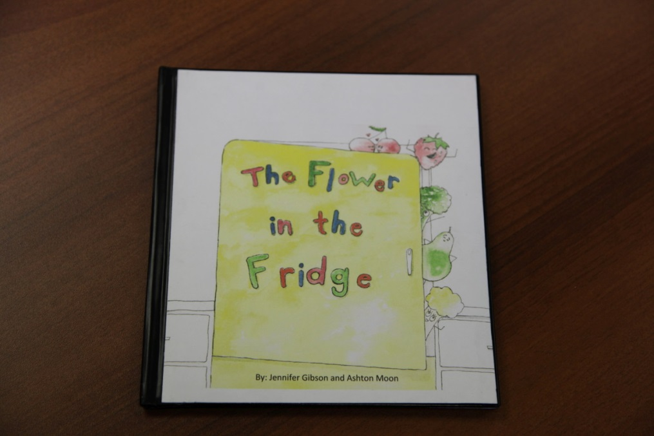
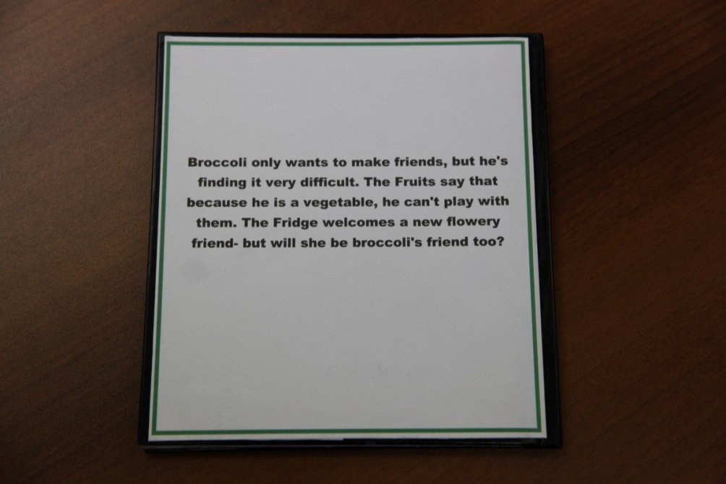

Slide 18
Publishing Resources
Writers Digest- http://www.writersdigest.com/
Association of Canadian Publishers- http://publishers.ca
Writer’s Relief- http://writersrelief.com/writers-associations-organizations/
Authors Learning Center- https://www.authorlearningcenter.com/
Perfect Pitch- http://myperfectpitch.com/book-publishers-in-ontario/

Slide 19
References
http://w.newtechnetwork.org/sites/default/files/news/pbl_research2.pdf
Forging Rhetorical Subjects: Problem-Based Learning in the Writing Classroom. Rosinski, Paula; Peeples, Tim. Composition Studies, v40 n2 p9-32 Fall 2012.
Garran, D. K. (2008). Implementing Project-Based Learning to Create "Authentic" Sources: The Egyptological Excavation and Imperial Scrapbook Projects at the Cape Cod Lighthouse Charter School. History Teacher, 41(3), 379-389.

