Slide 1
MedEd Portal/Dream
Presented May 19, 2014
Richard Sabina, PhD
Associate Professor, Biomedical Sciences
OUWB School of Medicine

Slide 2
CME Information
Objectives: At the conclusion of this activity, learners should be able to:
Review the MedEdPortal Directory and Repository of Educational Assessment Measures
Review the MedEdPortal end user experience and establish an account
Participate in an educational resource download demonstration from the DREAM collection of publications
CME Accreditation and Credit Designation
William Beaumont Hospital is accredited by the Accreditation Council for Continuing Medical Education (ACCME) to provide continuing medical education for physicians.
William Beaumont Hospital designates this live activity for a maximum of 0.75 AMA PRA Category 1 Credit(s)™. Physicians should claim only the credit commensurate with the extent of their participation in the activity.
This activity is eligible for meaningful participation (MP) credits.
View the CME handout for instructions on claiming credits.

Slide 3
Medical Education Week Posters
Available for viewing May 19-23 at:
Beaumont Royal Oak – Administration Building & Suite 100
Beaumont Troy – Atrium*
Beaumont Grosse Pointe – Healing Garden Corridor
OUWB O’Dowd Hall
Abstracts available:
www.oakland.edu/medicine/mededweek2014/posters
*Due to Magnet Site visit, posters only available May 19 & 20

Slide 4
Consultation Session: Preparing Dossier Promotion Packets
Deirdre Pitts, Director of Faculty Affairs and Professional Development, will be available to answer questions about the process of preparing a dossier promotion packet.
Hours and locations:
Monday, May 19 and Tuesday, May 20, 2014 • 9 a.m. – 3 p.m.
Administration Building West • Conference Room B
Wednesday, May 21, 2014 • 9 a.m. – 3 p.m.
Administration Building East • CEME office

Slide 5
Faculty Information
Dr. Sabina joined the faculty at the Oakland University William Beaumont School of Medicine in July 2009 as an Associate Professor of Biomedical Sciences and Discipline Director for Biochemistry.
At the OUWB School of Medicine, he directs the M1 Biomedical Foundations of Clinical Practice courses and chairs the M1/M2 Curriculum Subcommittee. Dr. Sabina serves on the Committee on Appointments, Promotion and Tenure, the Curriculum committee, the Ad-hoc Interprofessional Education Committee. He also served on the Admission Committee and Executive Committee.
Dr. Sabina is active in international education organizations, including the Association of Biochemistry Course Directors (ABCD), and serves as Past-Chair on the Executive Committee (ABCD-Ex). As Vice-Chair of the ABCDEx, he helped organize biennial ABCD Symposia. Dr. Sabina serves on the Steering Committee of the Team-Based Learning Collaborative, chairs the Educational Development committee and is a certified trainer-consultant for the TBL Collaborative. He is the MedEdPORTAL Associate Editor for Biochemistry & Genetics and takes part in its Faculty Mentor Program, which promotes the use of educational tools and encourages the submission of educational resources within MedEdPORTAL.
Disclosure
Dr. Sabina and all other individuals involved with this activity as planners or content reviewers have no relationship(s) with industry to disclose relative to the content of this CME activity.

Slide 6
MedEdPORTAL:
User Focus Publications
iCollaborative
CE Directory
Richard L. Sabina, PhD
Associate Professor of Biomedical Sciences
Oakland University William Beaumont School of Medicine
MedEdPORTAL Faculty Mentor
May 19, 2014

Slide 7
Faculty Mentor Session Objectives
Introduce the MedEdPORTAL suite of services:
Publications
iCollaborative
CE Directory
Identify purpose, focus and offerings of each service
Review the search, access and utilization of educational tools of interest
Demo live site
Notes:
Welcome to this informational session on the MedEdPORTAL program with a focus on sharing the purpose and tools made available in each of its three services: Publications, iCollaborative and the CE Directory. After providing a brief overview of each service, we will focus on the search for and access of tools of interest. If time permits, we can also explore the live site.

Slide 8
The vision of MedEdPORTAL is to
succeed as the most utilized, cited and influential destination for health education.
Notes:
MedEdPORTAL is a free, online service provided by the Association of American Medical Colleges. Through it’s three services – Publications, iCollaborative and the CE Directory - the overall vision of MedEdPORTAL is to succeed as the most utilized, cited and influential destination for health education.
Access as well as submission to each of these services is currently and will remain free to the public. Users log-in using their AAMC username and password. AAMC accounts are open for registration to the general public for free.

Slide 9
MedEdPORTAL Suite of Services
Publications
Serve as the premier clearinghouse of high quality, peer reviewed health education tools.
iCollaborative
Promote interprofessional collaboration by facilitating the open exchange of educational resources across the health professions.
CE Directory
Equip healthcare professionals across the continuum with effective and efficient educational resources to improve patient care.
Notes:
While that is the overarching mission for MedEdPORTAL, each service also has its own sub vision.
Publications was created to allow users to access peer reviewed, classroom tested health education tools. By accessing these complete, vetted modules, users can implement high quality materials at their own institution rather than spending both time and resources to create curricular pieces of their own. The rigorous peer review component backing Publications allows published authors to receive scholarly recognition for their publications. The formal citation and impact usage data they receive can be included within their CV packets in the support of promotion and tenure decisions.
iCollaborative aims to promote the sharing of and collaboration on innovative educational ideas being developed and tested at member institutions. These tools differ from those in Publications in that they are not MedEdPORTAL peer reviewed, they may not have yet been classroom tested and they may not be fully functioning as a complete learning module. The purpose of iCollaborative is just to get the materials shared across the health education community.
The CE Directory offers access to continuing education activities that were developed by faculty or staff at a non-commercial health institution, officially certified by an accrediting body, may be completed in their entirety through the online learning format. These activities are accessible through the hosting institutions’ continuing education websites. CE providers are encouraged to submit activities for inclusion in the CE Directory to increase visibility and traffic to their own site.

Slide 10
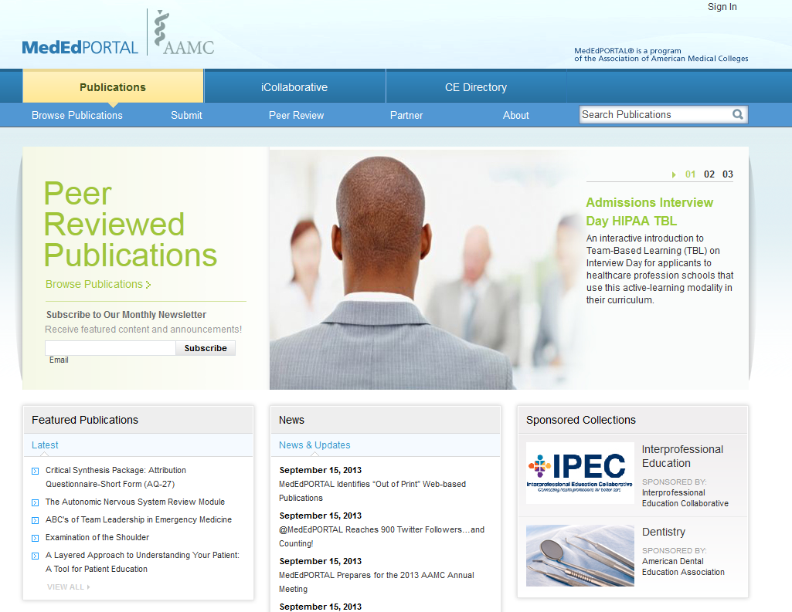
Notes:
This is a screenshot of the MedEdPORTAL website. At the top of the screen, there is a navigation bar that provides direct access to each of the three services – Peer Reviewed Publications, Non-MedEdPORTAL Peer Reviewed resources in iCollaborative and continuing education activities within the CE Directory.
We will briefly describe key features in each of the services starting with Publications.

Slide 11
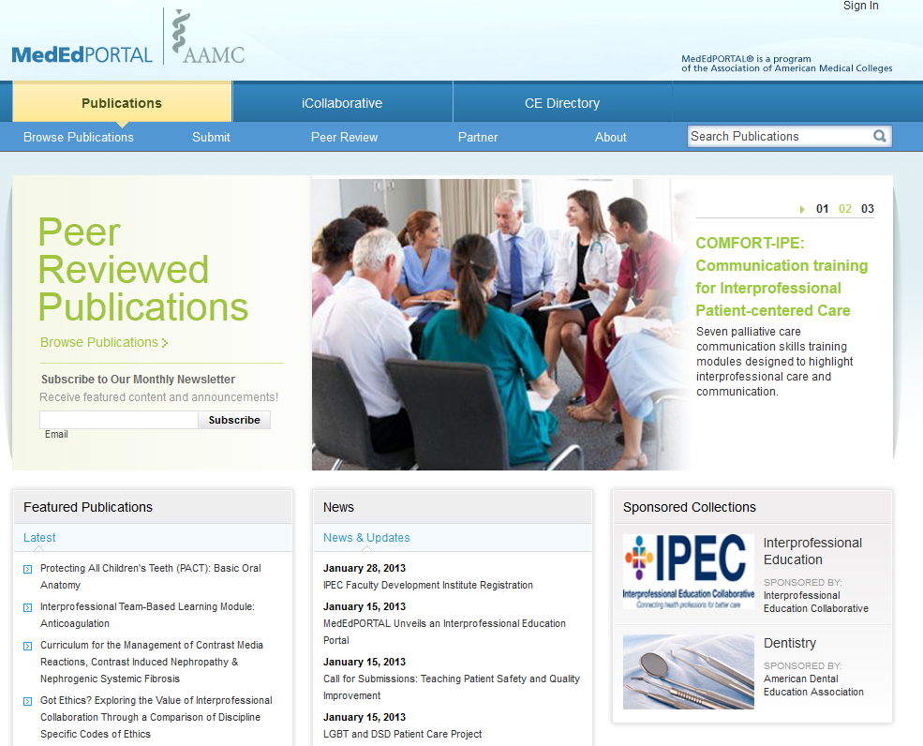
MedEdPORTAL Publications Overview
Free online publication service
Open to the general public around the globe
Peer reviewed health education teaching & assessment materials
Learning modules including instructor guides and all educational tools
www.mededportal.org
Notes:
Mouse Click 1 (Bullet 1) – As with each of its other services, MedEdPORTAL Publications is free to users and authors.
Mouse Click 2 (Bullet 2) - MedEdPORTAL publications are open and available to the general public around the globe. There are no restrictions as to who can create a user account and download published materials. However, there is a special collection of MedEdPORTAL resources designated as “special clearance” that restricts student access. Tools that are considered for this special collection include assessment tools. We will discuss this collection more later in this presentation.
Mouse Click 3 (Bullet 3) – All publications have been peer reviewed by two invited expert reviewers and currently cover the continuum of health education (e.g. undergraduate, graduate, and continuing education). Recently, the Publications and iCollaborative services have begun to receive materials for teaching and assessing pre-health students as well.
Mouse Click 4 (Bullet 4) – Accepted MedEdPORTAL publications are considered complete, “stand-alone” learning modules that include an Instructor Guide and all the necessary tools that will allow an educator to download, utilize, and implement the educational resource into the curricula at their own institution without ever having to contact the author. The Instructor Guides included within a MedEdPORTAL publication is one of the distinguishing featuresthat sets Publications apart from other MedEdPORTAL services.

Slide 12
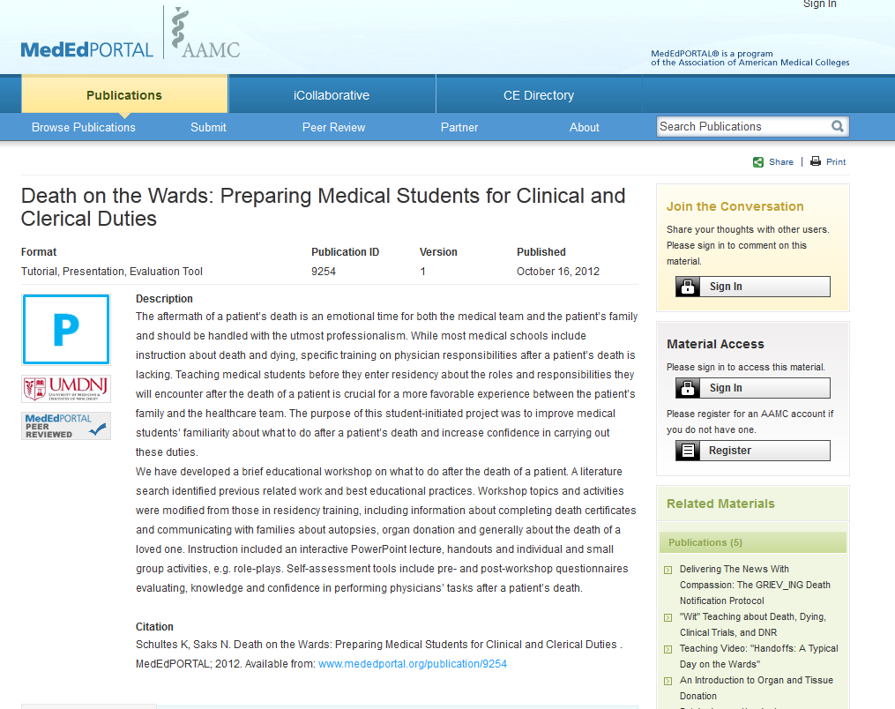
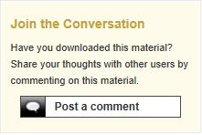
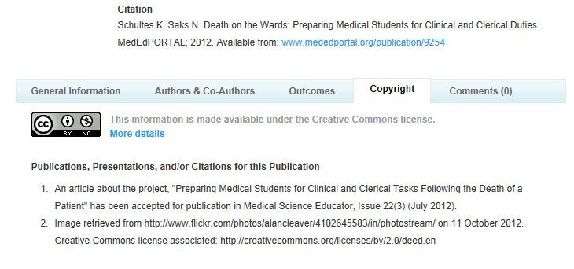
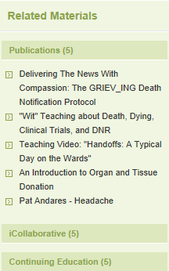
Sample Peer Reviewed Publication
Notes:
Now that we have spent some time focused on MedEdPORTAL Publications from the view of a prospective author, let’s walk through a typical MedEdPORTAL Publications abstract that would be seen as an end user interested in downloading the material.
In this publication, the authors have described their tool as an interactive, role-playing scenario that assists medical students who will be caring for a patient and family at the time of death.
Mouse Click 1 – Let’s review some key features of a peer reviewed Publication:
Mouse Click 2 – MedEdPORTAL has put considerable thought into ensuring that MedEdPORTAL Publications are distinguishable as pieces of educational scholarship that have been formally peer reviewed. All publications display this “P” logo.
Mouse Click 3 – The description provides a brief summary of the educational material.
Mouse Click 4 – All published authors receive a formal citation that can be included in their CVs to support promotion and tenure decisions.
Mouse Click 5 – This is a close-up view of the citation. It is important to note that published authors maintain the full copyright and ownership of their work despite having been peer reviewed and posted within MedEdPORTAL Publications. At the time of submission, authors dictate how they would like future end users to be able to utilize their materials. By answering three simple questions, the system auto-generates a creative commons license that is then affixed to the downloadable publication and is prominently displayed on the publication’s abstract page.
Mouse Click 6– Another distinguishing feature on a MedEdPORTAL Publication abstract is the MedEdPORTAL Peer Reviewed logo.
This logo does not appear on iCollaborative resources nor CE Directory activities because those resources have not been formally MedEdPORTAL peer reviewed.
Mouse Click 7 – Please note the “Join the Conversation” box in the top right hand corner of the screen. Publications abstracts include a threaded commentary feature that provide users the ability to leave feedback and present the opportunity to collaborate on future
projects. Published authors are notified by email when a user comments on their publication.
Mouse Click 8 – The MedEdPORTAL site utilizes a sophisticated search functionality - similar to Amazon.com - that pushes relevant content to the end user from all three MedEdPORTAL service - not just Publications.
This means that when you are reviewing an abstract in Publications, resources focused in similar content areas within iCollaborative and continuing education activities from the CE Directory will be populated and easily accessible.

Slide 13
Current Collections in Publications
Blah!
Building Oral Health Capacity (BOHC)
Interprofessional Education Collaborative (IPEC)
Patient Safety/ Quality Improvement
Directory and Repository of Educational Assessment Measures
Blah!
Notes:
MedEdPORTAL Publications has a series of collections that were created as a result of AAMC initiatives and federal or foundationally funded grants. Each publication in these collections were formally peer reviewed.
BOHC: The Building Oral Health Capacity collection, funded by HRSA, includes educational modules for oral health training in medical education with the goal of fostering coordinated, comprehensive patient care.
https://www.mededportal.org/about/initiatives/oralhealth
IPEC: The Interprofessional Education Collection, funded by the Macy Foundation, is a repository of competency-linked learning resources that aim to drive interprofessional education and team-based care.
https://www.mededportal.org/about/initiatives/ipe/
DREAM: The Directory and Repository of Educational Assessment Measures (DREAM) is a collection created in partnership with Georgia Regents University that offers high quality, peer reviewed assessment measures. Each publication contains a description of the validated assessment measure, an expert critical analysis of that measure, the assessment tool itself, and any supplementary materials that help administer that tool.
https://www.mededportal.org/about/initiatives/dream/
PS/QI: Our Patient Safety and Quality Improvement collection is the result of an AAMC initiative – Teaching for Quality (Te4Q) designed to increase the number of peer reviewed educational tools made available for our member medical schools and teaching hospitals as they aim to improve quality and patient safety.
https://www.aamc.org/initiatives/cei/te4q/

Slide 14
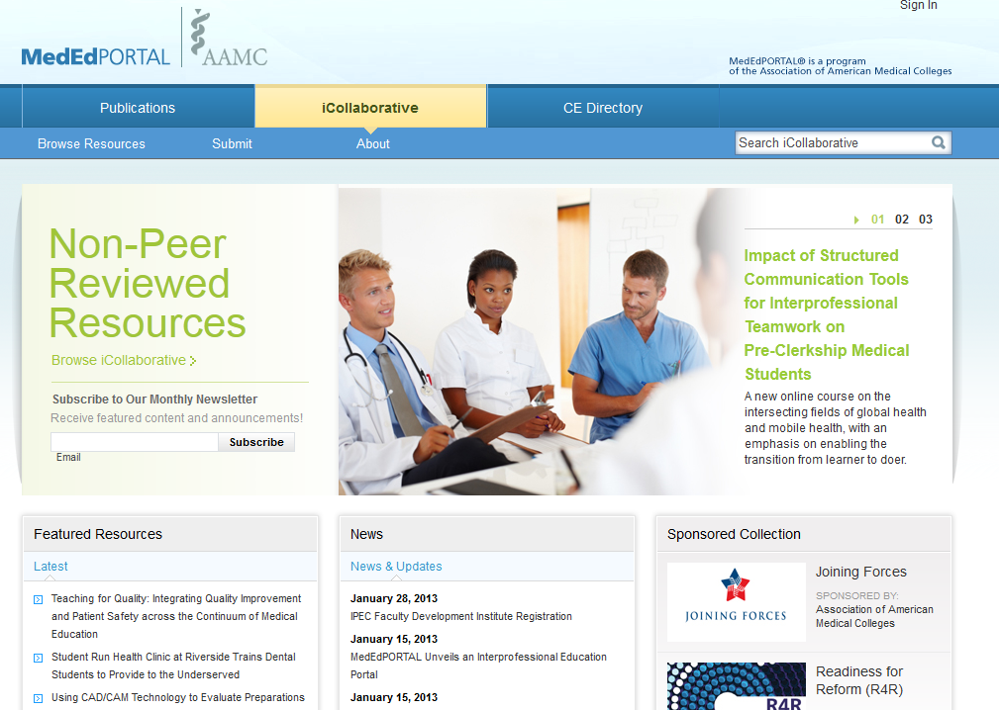
MedEdPORTAL iCollaborative
Notes:
Next, we will explore iCollaborative.

Slide 15
MedEdPORTAL iCollaborative Overview
Free online sharing and collaboration service
Open to the general public around the globe
Community building environment
Innovative approaches, practices, and strategies for transforming healthcare
www.mededportal.org/icollaborative
Notes:
Mouse Click 1 (Bullet 1) –iCollaborative is a free, online platform for sharing innovative approaches to transforming health education.
Mouse Click 2 (Bullet 2) - There are no restrictions on who can create a user account and download posted materials. There is no “Special Clearance” collection in iCollaborative.
Mouse Click 3 (Bullet 3) – iCollaborative is a community building environment where users are encouraged to share through social media platforms and provide feedback on postings through commentary and ratings.
Mouse Click 4 (Bullet 4) – Rather than offering the formally peer reviewed, classroom tested, stand-alone modules that we see in Publications, iCollaborative promotes the sharing of educational works that may still be in development or are otherwise not considered “complete.” As opposed to Publications, iCollaborative welcomes submissions of externally hosted materials. iCollaborative aims to connect health professionals in an interprofessional setting by sharing innovative approaches and tools for improving health education and enhancing patient care.

Slide 16
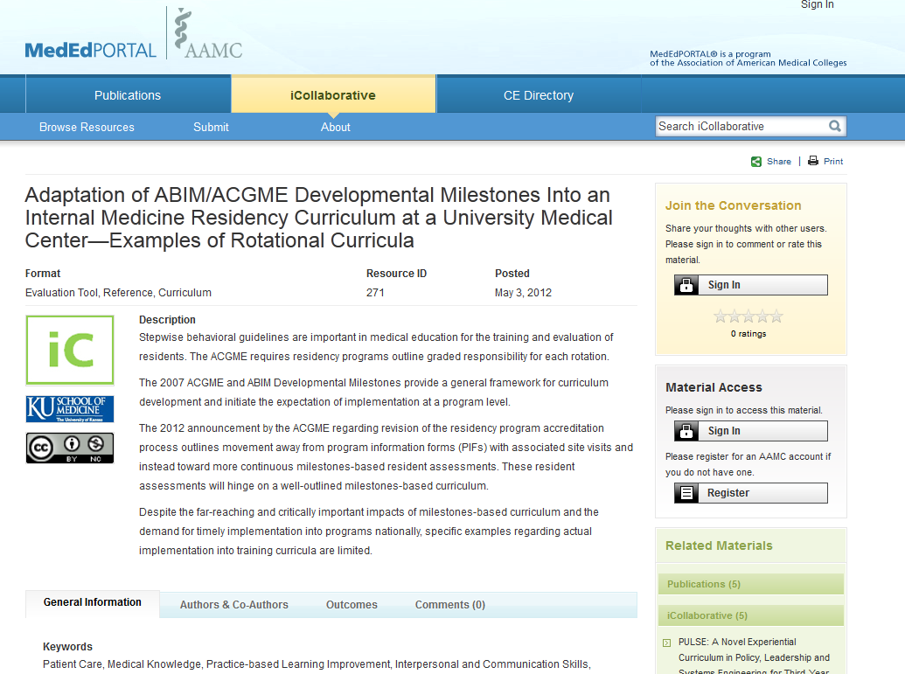
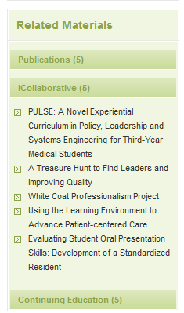
Sample iCollaborative Resource
Notes:
Mouse Click 1 – Let’s review the highlights of an Collaborative resource abstract.
Mouse Click 2 – Since iCollaborative resources are not formally peer reviewed by MedEdPORTAL, they do not carry the MedEdPORTAL Peer Review logo. Instead, they display an iCollaborative logo.
Mouse Click 3 – This resource describes an overview of a three year curricular framework that shifted resident assessments from program information forms with associated site visits to more continuous milestone based assessments. The downloadable resource files show an example of how the institution incorporated milestone language into their university-based internal medicine residence program. In addition to an overview of the three year curriculum, users can also download examples of the rotational curricula for several internal medicine experiences.
Mouse Click 4 – Please note that an iCollaborative resource posted within MedEdPORTAL does not receive a formal citation. This distinction is reserved for MedEdPORTAL Publications.
Mouse Click 5 – However, those submitting to iCollaborative will have the creative commons license: Attribution-NonComercial-ShareAlike. This license is displayed on the abstract as well as within all downloadable resource files.
Mouse Click 6 – iCollaborative abstract pages showcase not only the same threading commentary feature that we saw on the sample publication, but also a 5 star rating feature that is exclusive to iCollaborative.
As a platform for sharing and collaboration, we stress the availability of the “Join the Conversation” functionality.
Mouse Click 7 - Just as Publications pushes relevant content to the end user from all three of the MedEdPORTAL services, iCollaborative abstracts also display relevant content.
You’ll see here that the system is set up to show related materials specific to the particular service (Publications, iCollaborative, CE Directory) that you are currently visiting. However, each of the others sections can be expanded to display similar tools available in the other services.

Slide 17
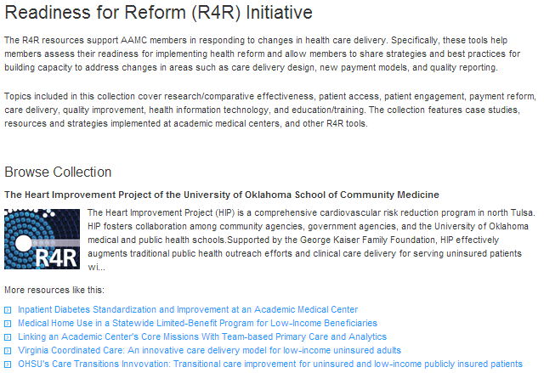
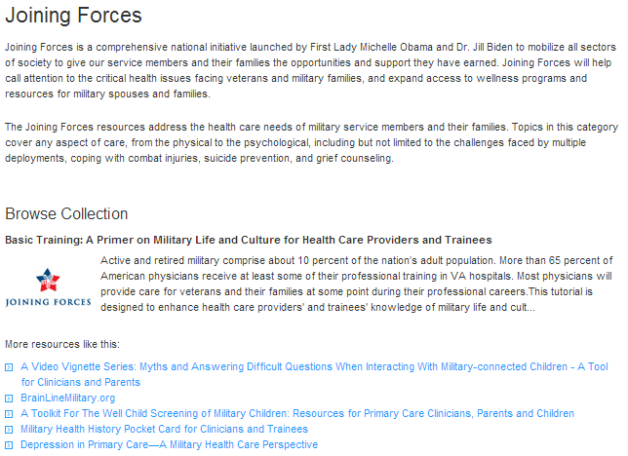
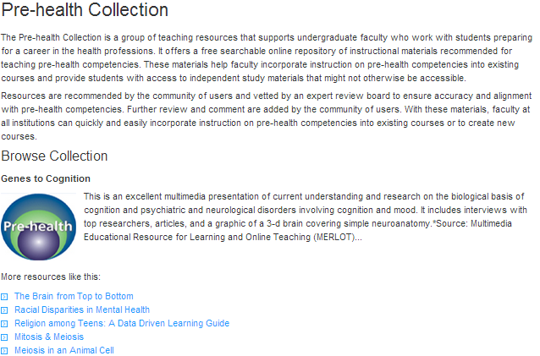
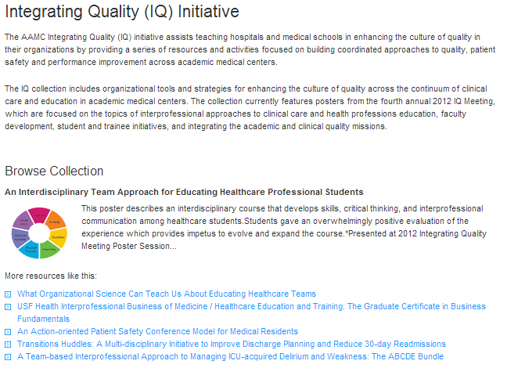
Collections in iCollaborative
Blah!
Blah!
Notes:
Collections within iCollaborative are largely the result of AAMC based initiatives.
Mouse Click 1A – The Readiness for Reform collection supports AAMC members in responding to changes in health care delivery models. Resources in this collection include innovative approaches in helping members assess their readiness for implementing health reform as well as strategies and best practices for building capacity to address changes in delivery design, payment models, and quality reporting.
Mouse Click 2A – The Joining Forces resources address caring for military service members and their families. Topics cover many aspects of care from the physical to the psychological such as challenges faced by multiple deployments, coping with combat injuries, and grief counseling. The goal of this collection is to prepare current and future generations of health care professionals in the caring for the military service community.
Mouse Click 3A – The Integrating Quality or IQ collection of resources focuses on building coordinated approaches to patient safety and performance improvement across academic medical centers.
Mouse Click 4A - The Pre-health collection is a group of teaching resources aimed to support undergraduate faculty as they work with students preparing for a career in the health professions. These materials help faculty incorporate instruction based on pre-health competencies into existing curricula and also provide students with access to independent study materials.

Slide 18
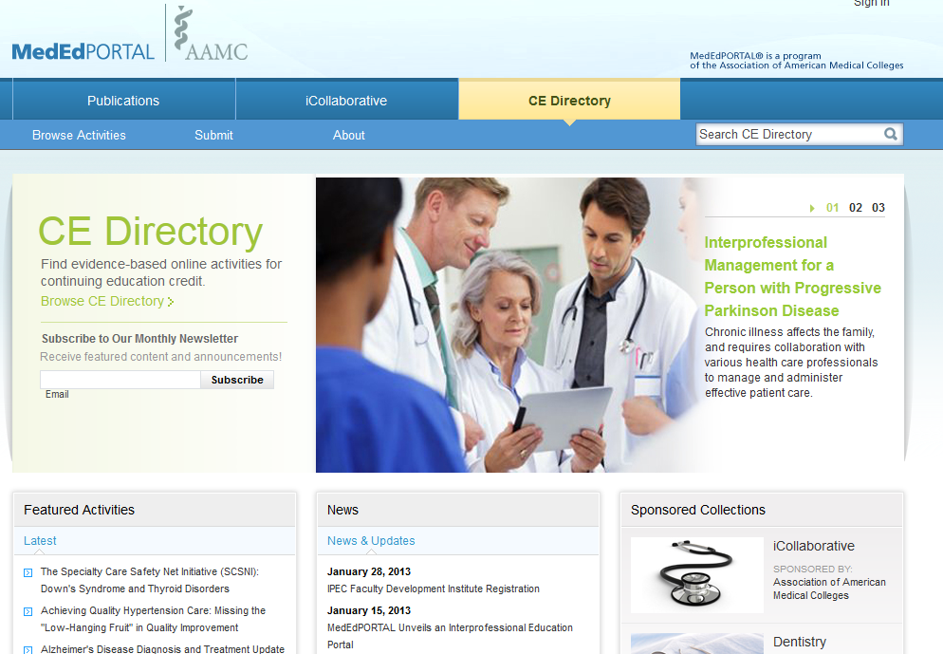
MedEdPORTAL CE Directory
Notes:
Lastly, the CE Directory service of MedEdPORTAL is designed to provide practicing health professionals with the ability to quickly search, find, and access high quality evidence-based online activities that offer CE credit and support lifelong learning, re-licensure, and maintenance of certification goals.

Slide 19
MedEdPORTAL CE Directory Overview
Free online continuing education directory service
Open to the general public around the globe
Search & Find high-quality, certified online CE activities
Promote activities created by faculty/staff at non-profit health organizations
www.mededportal.org/cedirectory
Notes:
Mouse Click 1 (Bullet 1) – The CE Directory offers free access to over 700 continuing education activities that have been officially certified by an accrediting body and are delivered in their entirely through an online format.
Mouse Click 2 (Bullet 2) – Access to the directory is open to the public but the availability of an individual activity is at the discretion of the institution which hosts the material.
Mouse Click 3 (Bullet 3) – The activities are searchable through the same vocabularies utilized by Publications and iCollaborative.
Mouse Click 4 (Bullet 4) – All activities have been created by faculty or staff from a non-profit organization.

Slide 20
CE Directory Submission Standards & Process Policies
Activities developed and administered by non-profit health institutions.
Activities certified by accrediting body.
Activities can be completed in their entirety through an online learning online format.
CE providers submit activities and select key fields allowing for optimal cataloguing and search functionality.
Notes:
CE providers are encouraged to submit certified activities that have been developed by faculty/staff from non-profit health institutions.
Activities must be made available through the institutions CE website and delivered through an online learning format. Registration and direct access to the course is made available through the home institution’s continuing education website.
Upon submission, CE providers identify key words and taxonomy selections that allow for the activity to be cross-referenced within the two other MedEdPORTAL services.

Slide 21
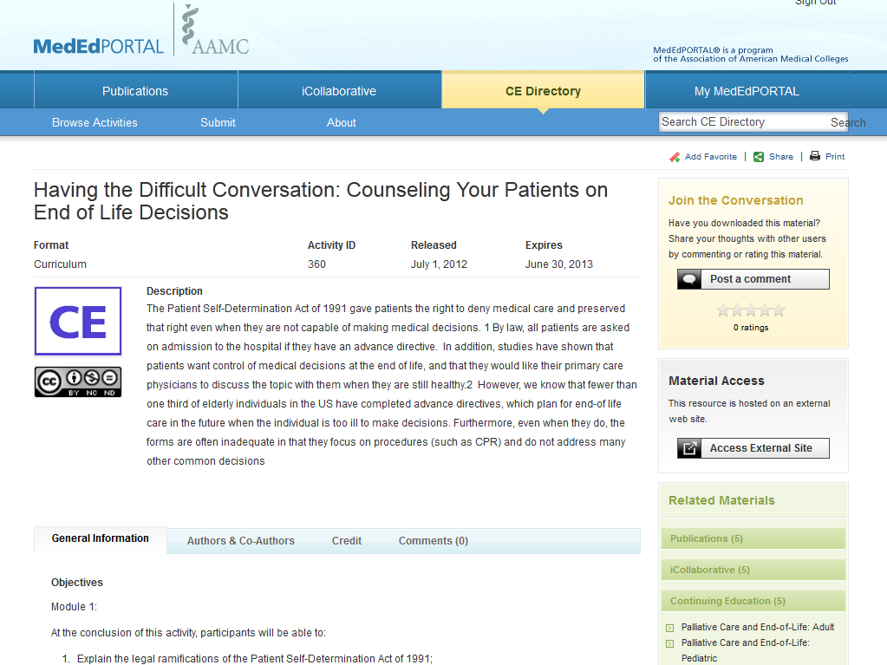
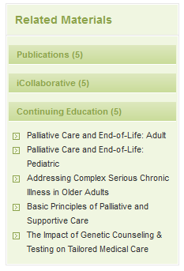
Sample CE Directory Activity
Notes:
Mouse Click 1 – Let’s review the different components that are specific to a CE Directory activity.
Mouse Click 2 – CE Directory activities are represented by a CE logo.
Mouse Click 3 – The focus of this course is counseling patients on end of life decisions based on information found in the Patient Self-Determination Act of 1991.
Mouse Click 4 – Specific to the CE Directory are the Released and Expiration Dates listed on the abstracts. Activities are removed from the directory when they have expired.
Mouse Click 5 – All activities within the CE Directory have been certified by an accrediting body. There is a specific credit tab on all CE activity abstracts.
Mouse Click 6 – Here, you will see that this activity has AMA PRA Category 1 Credit. Two credits are awarded upon completion and there is no charge.
Mouse Click 7 – All activities in the CE Directory are delivered through an online learning format but MedEdPORTAL does not host the material. Instead, the CE Directory points users to the institution’s CE website that hosts the activity of interest.
Mouse Click 8 - Like iCollaborative, users can rate activities and provide feedback through threaded commentary.
Mouse Click 9 – Lastly, as with the other services, CE Directory abstracts populate relevant peer reviewed publications and iCollaborative resources.

Slide 22
Collections in the CE Directory
Cultural Competency
End of Life Care
Interpersonal and Communication Skills
Interprofessional Care
Practice Management
Professionalism
Quality Improvement
Notes:
Collections within the CE Directory are grouped together by topical area such as Interprofessional care, professionalism, and quality improvement.

Slide 23
An Integrated Solution
The MedEdPORTAL Suite
PUBLICATIONS
Peer Reviewed Teaching/Assessment Tools
iCOLLABORATIVE
Non-MedEdPORTAL Peer Reviewed Innovative Educational Approaches and Strategies
CE DIRECTORY
Accredited Online Continuing Education Courses
CROSS-INDEXED
Notes:
A feature special to MedEdPORTAL is that these three services may offer different types and formats of educational tools but the site is completely integrated. Each service uses the same controlled vocabulary. When searching for a particular content area within Publications, the user will also have access to similar material that is hosted within the iCollaborative and the CE Directory.

Slide 24
Accessing Content: MedEdPORTAL blank search
Notes:
As we have described, reviewing a particular tool in one of the three services will allow for users to see what related resources are available in the other two portals. However, it is important to remember that each service has an independent search. Users are encouraged to use the MedEdPORTAL controlled vocabulary (taxonomy) to drill down their search and locate the tools that best fit their needs.
In this first video, we will do a “blank search” and filter the results using the MedEdPORTAL taxonomy.
PLAY VIDEO.
We will complete our blank search in the Publications portal. To complete this search, we will click the magnifying glass image without typing anything into the field box.
Within the search result, we recommend that you sort by “Most Recent” to see what’s new in the collection.
We also recommend always clicking “Show All” to display a bit more information about each publication: the author, institution and short description.
The column on the left hand side of the screen is where users can use the MedEdPORTAL taxonomy to filter their search results. Users can drill their search down by organ system, intended audience and other fields…
Selecting a specific health profession – here, selecting medical – allows the user to filter their search by specific specialties or competencies.
By clicking the competency “Interprofessional collaboration” will filter on publications that address this competency.
After selecting this competency, users can still filter further.
Again, it is best to click “Show All” to see more information about the publications.
Clicking on the title will bring the user to the publication abstract page.

Slide 25
Accessing Content: MedEdPORTAL keyword search
Notes:
For users who are interested in a particular content area, we recommended searching for it directly by typing into the open search field box. From there, the same filters can be used to focus the search further.
As an example, let’s search for “professionalism.”
We will sort by “Most Recent” and then click “Show All” to see the publications’ descriptions.
Next, we’ll filter a search by intended audience. Let’s focus on publications that are tailored for “Professional & Faculty Development.”
In our new search result, we will expand to show more information and then select the title that we are interested in accessing.

Slide 26
 | Publications | iCollaborative | CE Directory
Purpose | Recognize and advance educational scholarship Access peer reviewed, proven educational tools | Share innovative approaches to transforming health care education Collaborate on tools in development | Promote certified online continuing education activities
Standards | Stand alone module Clear learning objectives Classroom tested Ready for implementation Copyright/patient privacy compliance | Copyright/patient privacy compliance | Accredited Online learning format Created by faculty/staff at a non-profit health institution
Features | Peer Reviewed Author usage reports Formal citation for scholarly credit Special clearance assessment tools Published indefinitely | 5 star rating Threaded commentary Three year expiration | Quick, searchable by content area Access online learning outside home institution/specialty Removed when expired
MEP Peer Reviewed | Yes | No | No
Formal Citation | Yes | No | No
Notes:
This final slide details the distinct features of each service within MedEdPORTAL. Publications was created as a venue for teaching faculty to receive recognition for their pieces of educational scholarship as well as to provide members with access to peer reviewed, proven educational tools. Publications are considered stand-alone teaching modules with clear learning objectives. They have been classroom tested and are ready for implementation by others. Published authors have access to real time usage reports and receive a formal citation for scholarly credit. Key features of Publications are the “Special Clearance” collection and the fact that tools are published indefinitely, similar to research articles published in a traditional print-based journal.
iCollaborative was created for members to share innovative approaches to health care education and to collaborate on tools still in development. iCollaborative offers a 5-star rating feature and threaded commentary. Submitters do not receive a formal citation upon posting and their resource will be removed from the system after three years. Upon removal, MedEdPORTAL staff will contact the submitter and encourage him/her to submit a more recently updated version.
Lastly, the CE Directory aims to promote continuing education activities that have been developed by faculty/staff at non-profit health organizations, certified by an accrediting body, and are available for completion through the online learning format. These activities are easily searchable through the same controlled vocabulary that is used across the entire website and will be removed when the activity expires.

Slide 27
Demo Live Site
www.mededportal.org
Notes:
Ideas for demo:
Search for and download content from Publications and iCollaborative.
Search for a CE Directory activity and visit an externally hosted CE provider website.
Locate the Submission Instructions pages for each service.
“Browse” each service.

Slide 28
Questions?
Richard Sabina, PhD
Phone: 248-370-2755
Email: sabina@oakland.edu
Michael T. Fitch, MD, PhD
Director, Faculty Mentor Program
mfitch@wakehealth.edu
Emily Cahill, MPH Hannah Kittel
MedEdPORTAL Director & Managing Editor MedEdPORTAL Staff Editor
ecahill@aamc.org (formerly Novinskie) hkittel@aamc.org

Slide 29
Reminder: Claim CME/MP Credits Online
https://www.surveymonkey.com/s/ouwb14
IMPORTANT ----- Credits must be claimed online by July 2, 2014;
after this time, CME credit will no longer be available.
CME Activity Code is Required to Claim Credits – See CME Handout
(Code varies based on viewing location)

