Slide 1

Poster Podium Presentations
Presented May 20, 2014
Justine Nasr,
Nicole Lederman, OUWB School of Medicine Class of 2015
Jason Wasserman, Assistant Professor of Biomedical Sciences

Slide 2

CME Information
Objectives: At the conclusion of this activity, learners should be able to:
Identify innovative curricula in medical education
Develop skills to become effective Medical Educators
Discuss resources for leadership development
Identify methods to allow for self directed learning opportunities
CME Accreditation and Credit Designation
William Beaumont Hospital is accredited by the Accreditation Council for Continuing Medical Education (ACCME) to provide continuing medical education for physicians.
William Beaumont Hospital designates this live activity for a maximum of 1.5 AMA PRA Category 1 Credit(s)™. Physicians should claim only the credit commensurate with the extent of their participation in the activity.
This activity is eligible for meaningful participation (MP) credits.
View the CME handout for instructions on claiming credits.

Slide 3
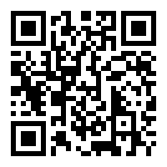
Medical Education Week Posters
Available for viewing May 19-23 at:
Beaumont Royal Oak – Administration Building & Suite 100
Beaumont Troy – Atrium*
Beaumont Grosse Pointe – Healing Garden Corridor
OUWB O’Dowd Hall
Abstracts available:
www.oakland.edu/medicine/mededweek2014/posters
*Due to Magnet Site visit, posters only available May 19 & 20

Slide 4
Consultation Session:
Preparing Dossier Promotion Packets
Deirdre Pitts, Director of Faculty Affairs and Professional Development, will be available to answer questions about the process of preparing a dossier promotion packet.
Hours and locations:
Monday, May 19 and Tuesday, May 20, 2014 • 9 a.m. – 3 p.m.
Administration Building West • Conference Room B
Wednesday, May 21, 2014 • 9 a.m. – 3 p.m.
Administration Building East • CEME office

Slide 5
Faculty Information
Justine Nasr
Justine grew up in Troy, MI prior attending Wayne State University for college. She then attended the University of Michigan of Medical School where she went on to match at Beaumont Hospital Royal Oak for Internal Medicine Residency where she is now a 2nd year resident.
Nicole Lederman
Nicole is a rising M4 student at OUWB. She graduated from the University of Michigan, where she received bachelors degrees in biology and music, and went on to complete a term of service with the Community HealthCorps prior to attending medical school. Nicole is considering pursuing a combined residency in family medicine and psychiatry, with the goal of integrating mental health into the primary care setting. Her interests in the doctor patient relationship and the study of compassion stemmed from her experiences clowning for patients in nursing homes and hospitals.
Disclosure
Justine Nasr, Nicole Lederman, Jason Wasserman, Dr. Ernest Krug and all other individuals involved with this activity as planners or content reviewers have no relationship(s) with industry to disclose relative to the content of this CME activity.

Slide 6
Faculty Information
Dr. Wasserman joined the OUWB faculty as a tenure-track assistant professor in July of 2013 where he teaches medical humanities and clinical bioethics. He has previously faculty positions in the Department of Sociology at Texas Tech University and the Department of Bioethics at Kansas City University of Medicine and Biosciences. His scholarly work has focused on the medicalization of homelessness, the sociological impacts of the epidemiological transition on medicine, and the influences of neighborhood infrastructures and community networks on health outcomes among the urban poor.
Along with a 2010 book entitled At Home on the Street: People, Poverty, and a Hidden Culture of Homelessness, coauthored with Jeffrey Michael Clair, Ph.D., Dr. Wasserman has published 4 peer-reviewed book chapters and 25 peer reviewed articles in journals such as Social Science and Medicine, Journal of Contemporary Ethnography, Journal of Medical Ethics, Journal of Curriculum and Pedagogy, and Journal of Physical Activity and Health. He also co-directed a documentary film supplementing his book, entitled American Refugees: Homelessness in Four Movements (2011). Additionally, he recently served as an Associate Editor for Blackwell’s Encyclopedia of Health, Illness, Behavior, and Society.
Dr. Wasserman majored in philosophy with a focus on applied ethics, receiving a B.A. from University of Alabama at Birmingham in 2001. He earned a master of arts in medical sociology in 2005, and a Ph.D. in medical sociology in 2007, both from the University of Alabama at Birmingham. While new to OUWB, Dr. Wasserman has assumed course directorship of the Medical Humanities and Clinical Bioethics courses for the first-year students, as well as serving on the Capstone Advisory Committee, Student Progress Review Committee, and the Professionalism Subcommittee, as well as beginning to mentor several capstone research projects. He is a member of the American Society for Bioethics and Humanities, American Sociological Association, and the International Sociological Association and he has given invited presentations locally, nationally, and internationally. His book, At Home on the Street, was recently awarded honorable mention, (1st runner up) for the Annual Book Award from the Association for Humanist Sociology.
Disclosure
Justine Nasr, Nicole Lederman, Jason Wasserman, Dr. Ernest Krug and all other individuals involved with this activity as planners or content reviewers have no relationship(s) with industry to disclose relative to the content of this CME activity.

Slide 7
Faculty Information
Dr. Krug joined the Oakland University William Beaumont School of Medicine in 2010. He is professor of Biomedical Sciences and Pediatrics and course director for the longitudinal course in Medical Humanities and Clinical Bioethics at the OUWB School of Medicine. Dr. Krug received his B.A. from Harvard College, the M.Div. from Union Theological Seminary in New York City, and M.D. from the University of North Carolina at Chapel Hill.
He completed pediatric training in Boston at the Massachusetts General Hospital and the Children’s Hospital Medical Center, and completed a fellowship in Developmental Pediatrics at the William Beaumont Army Medical Center in El Paso, Texas while on active duty in the U.S. Army. He retired in 2012 from clinical practice in developmental-behavioral pediatrics. Dr. Krug has been involved in clinical ethics for over 25 years. He retired from his position as Corporate Director of Clinical Bioethics in the Beaumont Health System in 2012.
Disclosure
Justine Nasr, Nicole Lederman, Jason Wasserman, Dr. Ernest Krug and all other individuals involved with this activity as planners or content reviewers have no relationship(s) with industry to disclose relative to the content of this CME activity.

Slide 8
Structured Senior Morning Report to Promote EBM Learning
Justine Nasr, MD; John Falatko, DO; Michael Barnes, MD; Lynda Misra, DO
OUWB School of Medicine Medical Education Week
May 2013

Slide 9
Objectives
To share our standardized and structured format for introducing EBM to our residents to other resident educators.
To demonstrate ease of integrating structured clinical questions, literature searches, and appraisal into resident education.
To promote further discussion of and interaction with medical literature in general.

Slide 10
Outline
Background
Senior Morning Report (SMR) Outline
  Example
Critical Appraisal
Feedback

Slide 11
Goals of SMR
To improve the residents’ ability to:
  Form pertinent clinical questions
  Access medical literature
  Critically appraise literature
  Understand various statistical methods
To make implementing EBM more comfortable and less daunting.

Slide 12
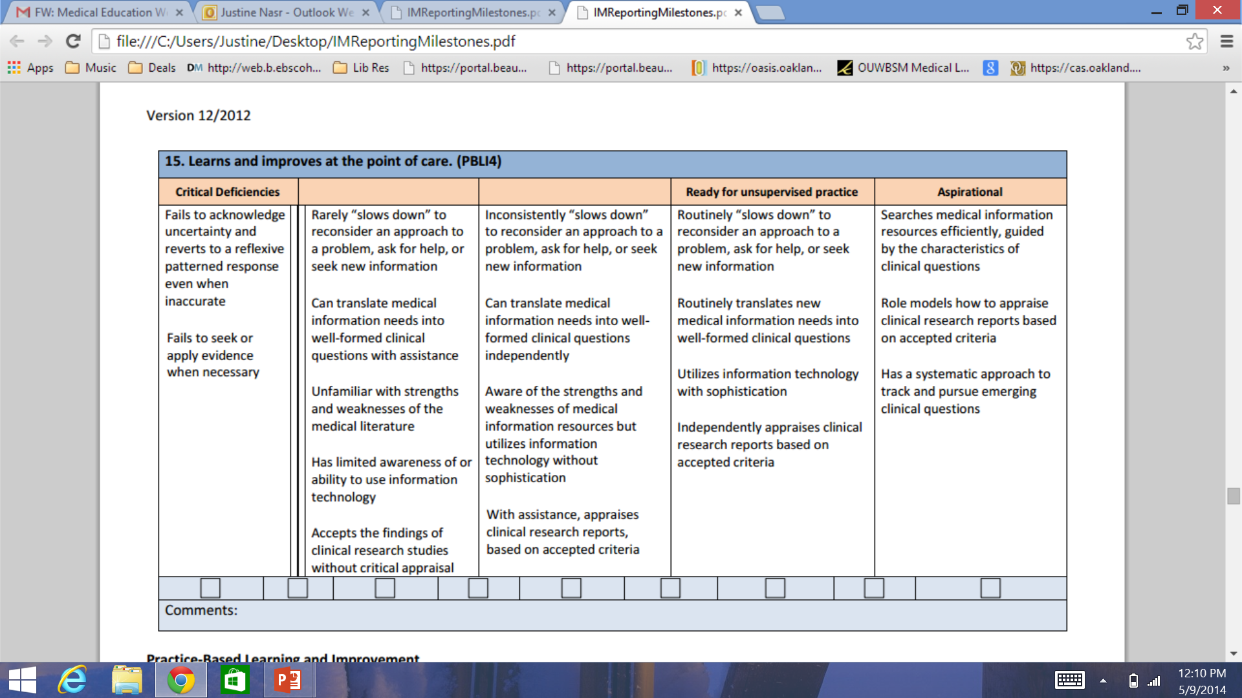
Milestones

Slide 13
Senior Morning Report
Once a month for floor seniors
  Outline provided for guidance.
  Appraisal worksheets from JAMAEvidence
Clinical questions developed based on a patient seen by the resident.
EBM dedicated faculty available
A variety of baseline EBM skills are represented
Notes:
I will bring my pocket book to the presentation.
EBM faculty help with PICO questions, search, critical appraisal, and statistics.

Slide 14
SMR Outline
Case Presentation
Presenting the Question
  Should be written in PICO format
    Patient population of interest
    Intervention being investigated
    Comparison to population, test, or intervention that is standard
    Outcome
Finding your answer
Notes:
CP-we keep it brief. Finding your answer—what I like to call the search—what you accessed, what you typed, how you refined

Slide 15
Herpes Zoster Vaccine and Recurrent Herpes Zoster
Justine Nasr
Internal Medicine
Senior Morning Report
July 2013

Slide 16
Case
A 60 year old male presents with chief complaint of neck swelling and rash that started two days prior to presentation after getting a hair cut in Tennessee.
He denies fever, chills, malaise. The rash is mildly pruritic, but not painful at the time of presentation.
PMHx: Ulcerative Colitis s/p colectomy with ileostomy.
Family Hx: HTN in his mother
Social Hx: never smoker, 1-2 glasses of wine/week. Denies illicit drug use.

Slide 17
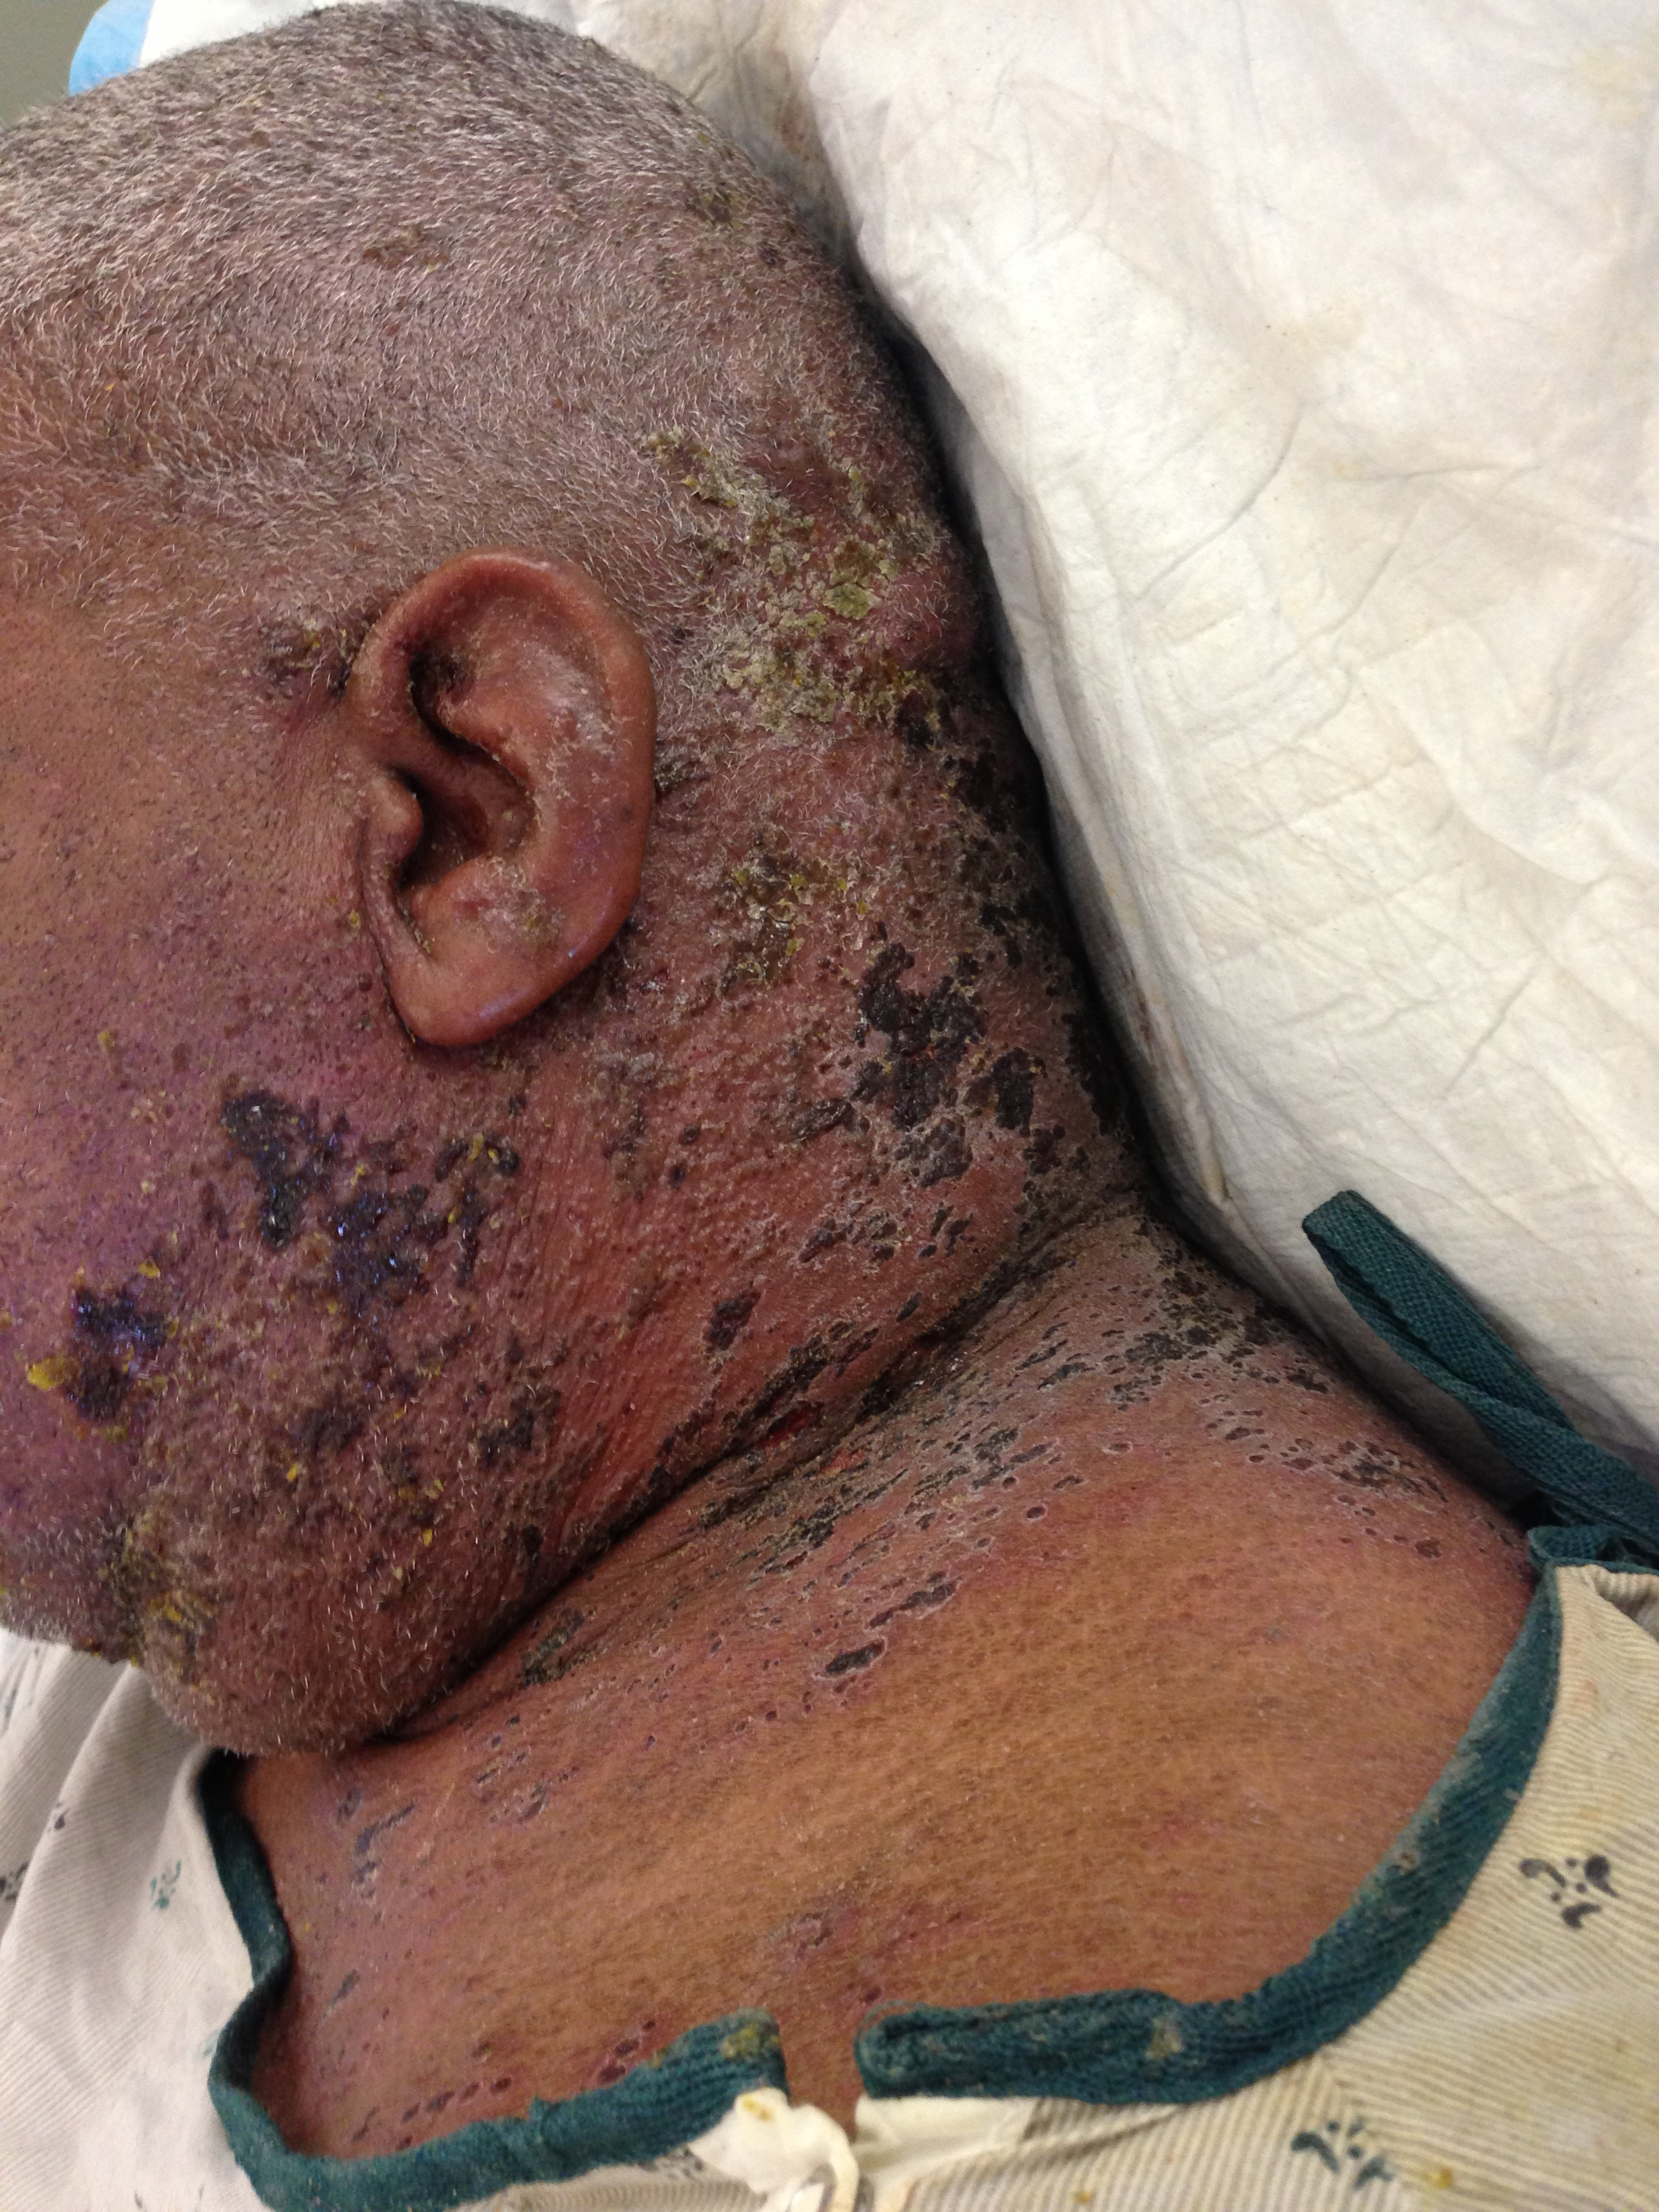
Case
Physical Exam:
  Vital Signs: BP 171/55 HR 86 RR 14 SPO2 96% on RA
  HEENT: neck is edematous with left neck edema >right, it is non pitting. Eschar and erythematous macules, papules and crusting ulcerations on posterior neck lateral shoulder, sternum in multiple stages.
  CVS: regular in rate and rhythm
  Lungs: Clear
  Skin: above findings as well as keloid noted on posterior occiput.
Notes:
Receives standard treatmetns for HZ-acycloir;

Slide 18
Clinical Query (PICO)
In a 60 yo male with history of herpes zoster (population) does herpes zoster vaccination (intervention) decrease the recurrence rate of herpes zoster (outcome) when compared to those who are not vaccinated (comparison group)?
  P- immunocompetent adults with shingles
  I- herpes zoster vaccine
  C- unvaccinated immunocompetent adults
  O- decrease recurrence rate

Slide 19
The Search
“herpes zoster vaccine and recurrent herpes zoster”
31 articles on Pubmed
1 article that fit my search criteria
Recommendations also reviewed on CDC website and Dynamed
Notes:
Original search was much larger, but then focused by adding “immunocompetent host”

Slide 20
SMR Outline
Article Characteristics
  Journal Impact Factor
  Study Design
  Study Duration and location
Background
  why the study was performed
Notes:
Impact factor is controversial in our program.
Design (Randomized control trial, case-control, meta-analysis etc.)
Multicenter vs single, US vs other country

Slide 21
SMR Outline
Methods
  Inclusion and exclusion criteria
  Clearly define primary endpoint
  Strategy to control bias
  Explain statistics
Results
  Include important disparities in baseline characteristics
  Include numeric reporting important results and graphs
Notes:
bias (randomization, parties blinded, placebo, etc.)
statistical analysis strategies noted in results (power analysis, sub group analysis, heterogenity, C-statistic)

Slide 22
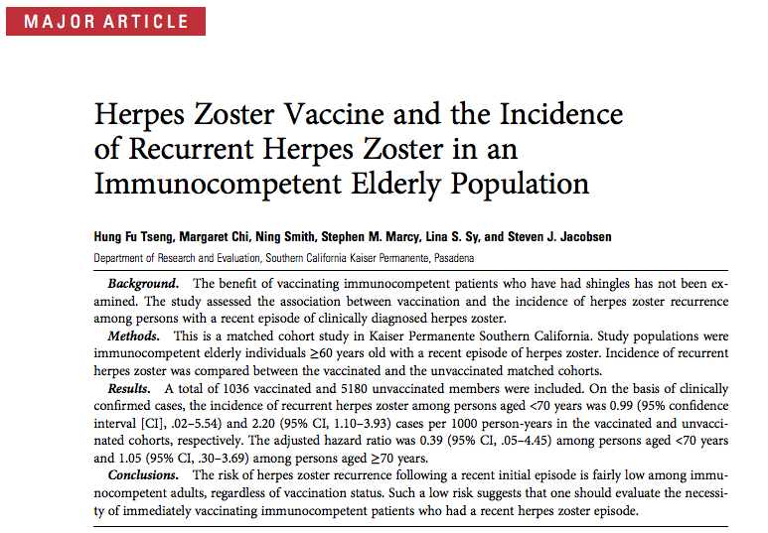

Slide 23
Article Review
Published in The Journal of Infectious Disease (IF 6.4)
Prospective from January 1st 2007 to December 31st 2010.
Cohort
Kaiser Permanente Southern California

Slide 24
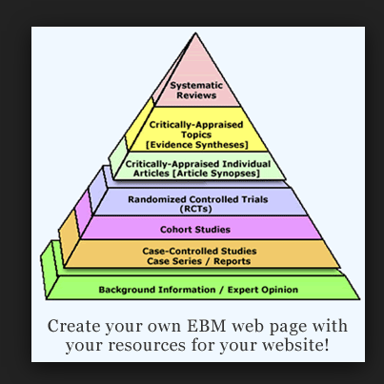
Image from: http://www3.mdanderson.org/library/evidence-based/index.html
Notes:
Methods/results/statistical analysis slides were removed

Slide 25
SMR Outline
Discussion from the authors
Clinical application to the patient
Appraising the article
  Choose the appraisal sheet that best suits your article and answer appraisal questions.
Notes:
Present the authors opinion and critiques
Present your own thoughts on the impact of the results and your own critiques

Slide 26
Discussion
It is uncommon to have HZ recurrence in immunocompetent population, making the study inadequate.
Difficult to “confirm” cases as HZ is not usually diagnosed with laboratory tests.
Short term follow up-4 years.
Not RCT
Notes:
My thoughts on the study.
What we did in real life. No recommendation for vaccination.

Slide 27
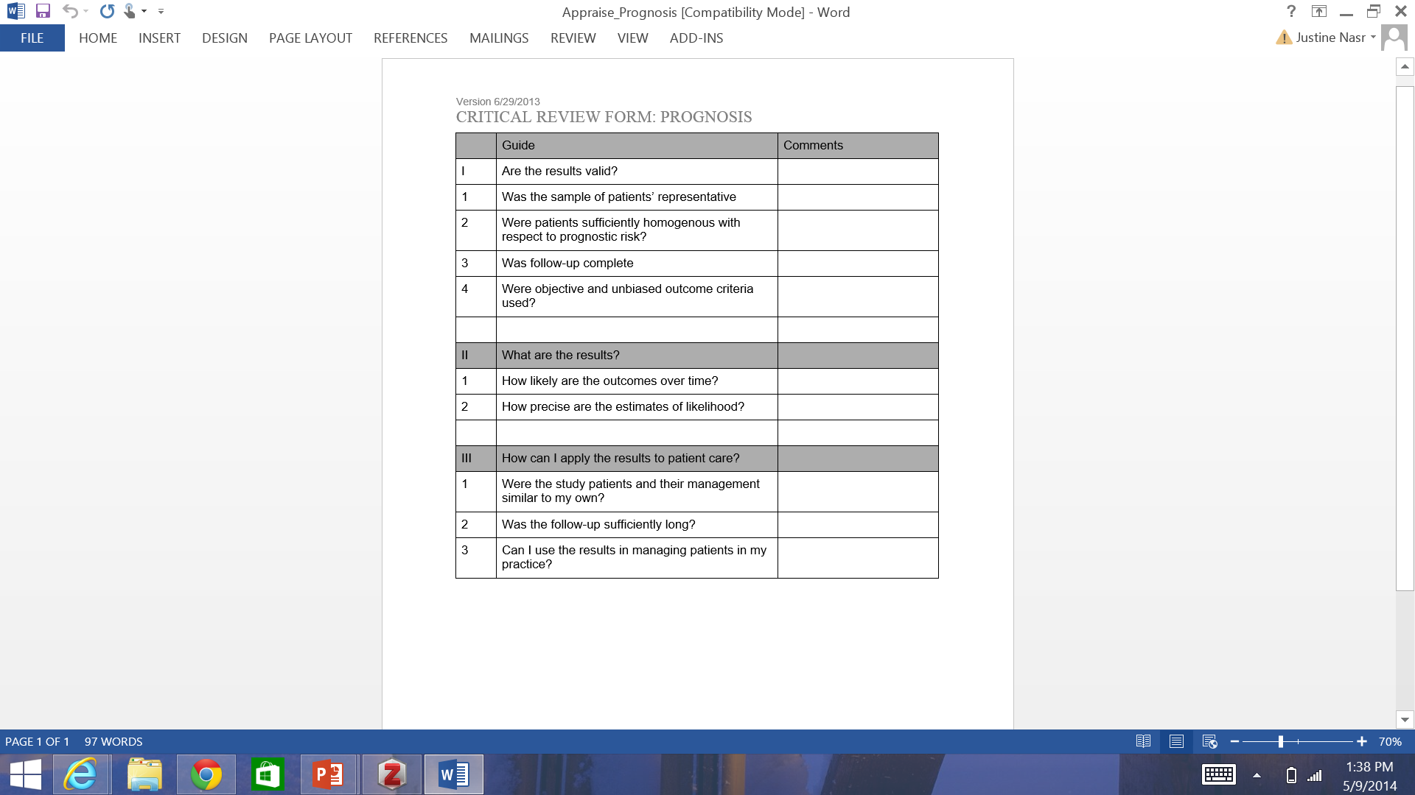
Appraisal Worksheets
Notes:
Our most popular appraisal is therapy with the appraisal sheet focusing on RCTs

Slide 28
Feedback
Real time by peers and mentors
Official feedback based on above milestones placed in residents’ file.

Slide 29
Outline
Background
Senior Morning Report (SMR) Outline
  Example
Critical Appraisal
Feedback

Slide 30
References
JAMAevidence Education Guides. Available at: http://jamaevidence.com/edguides. Accessed May 9, 2014.
Guyatt G, Rennie D, Meade MO, Cook DJ, eds. Users’ Guides to the Medical Literature. 2nd ed. McGraw-Hill Medical; 2002
Lobst W, et al. Internal Medicine Milestone Project A Joint Initiative of The Accreditation Council for Graduate Medical Education and The American Board of Internal Medicine Chair. Accessed May 9, 2014.
Dahm P, Scales CD. Teaching and Assessing Evdience Based Medicine in the Age of Milestones. ACGME. Available at http://www.acgme.org/acgmeweb/Portals/0/PDFs/2014AEC-Presentations/ses038.pdf. Accessed May 9, 2014.

Slide 31
Thank You!
?
Notes:
Dr. Misra and Dr. Barnes and John
Coordinators of this week.

Slide 32

A Needs Assessment for Integrating Compassion into
A Medical School Curriculum
Nicole Lederman
Notes:
-Colors: black or dark beaumont red.
-Aim for 20 slides, spend 1 minute per slide, 4 bullets per slide
-Keep short and sweet until findings and discussion

Slide 33
Acknowledgements
Nelia Afonso, M.D.
Tracy Wunderlich

Slide 34
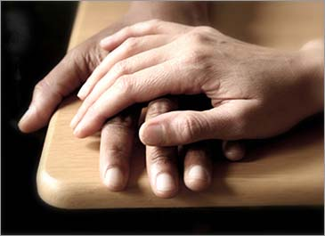
Background
Medical schools are starting to focus on the development of the compassionate physician
Core competencies of medical training
Humanism: altruism, integrity, respect for others, and compassion; physician’s attitudes and actions that demonstrate interest in and respect for the patient and that address the patient’s concerns and values
How do you teach a medical student to be kind?
Notes:
In healthcare there has been a push to move to provide more patient centered care
The inspiration from this project came from Dean Folberg’s vision for this medical school. At my interview day, he posed the question: How do you teach a medical student to be kind?” These words were truly refreshing. I entered medical school with grandiose dreams of healing and connecting with my patients.
For graduation, students are expected to acquire certain competencies, rather than simply gaining knowledge. Society expects a physician to be knowledgeable but also someone who is a good listener, an effective communicator, and a physician that knows how to be kind and compassionate.
This study focuses on the latter components of kindness and compassion.
Along with the acquiring a core competency of professionalism and ensuring that patients receive the best care possible, practically speaking, compassionate physicians are less likely to be sued, better able to develop a trusting doctor patient relationship, and thus have increased success with patient compliance
Despite hearing this message over and over again, students do not have a concrete way to measure this behavior with their patients
A word to key in on that showed up repeatedly in the literature is that of humanism, encompassing altruism, integrity, respect for others, and compassion.
3 key identifiers included experiences with great intensity, volunteer and role modeling as being instrumental to the development of compassion in students
Solutions that I found particular application included developing pragmatic teaching methods that can be used in the fast paced setting of a clinical environment with faculty feedback, and time to reflect along with a standardized patient exam experience that suggested that these tools can be used to assess empathy, a sister concept to compassion.

Slide 35
Aims
Understand the need to include training on compassion in medical school
Explore perceptions of compassion through the use of focus groups
Findings could inform the creation of an educational tool
Notes:
Objectives from IRB application
-Use words like evaluating and measuring
-To explore the perceptions of compassion through the use of focus groups
*Qualitatively in order to capture nuances related to topic

Slide 36
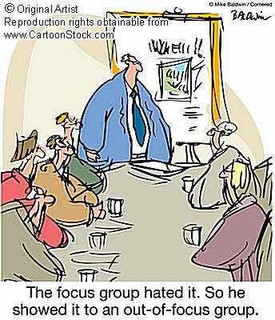
Methods
2 Focus groups
  Standardized Patients
  Medical Students
4 Physician interviews
4 Questions
Thematic Analysis
Notes:
-Study Overview: Who is in the study, methods (audio recordings, focus groups)
-Coded data using aspects of grounded theories (develop as you go along) Glaser and Strauss use to analyze qualitative data rather than forming hypothesis prior to data collection your hypothesis comes out after analysis
-Talk about questions before

Slide 37
Questions
Describe a compassionate physician.
Should compassion be part of a medical school curriculum?
Can compassion be taught and/or measured?
Provide an example…

Slide 38

Compassion = Empathy + Action
Results- Describe a compassionate physician.
Effective communication: ensure that the patient is as informed and comfortable as possible
-Validates, offers reassurance and explanations
Balance between physician goals and patient’s goals
In that moment, the patient is the most important.

Slide 39
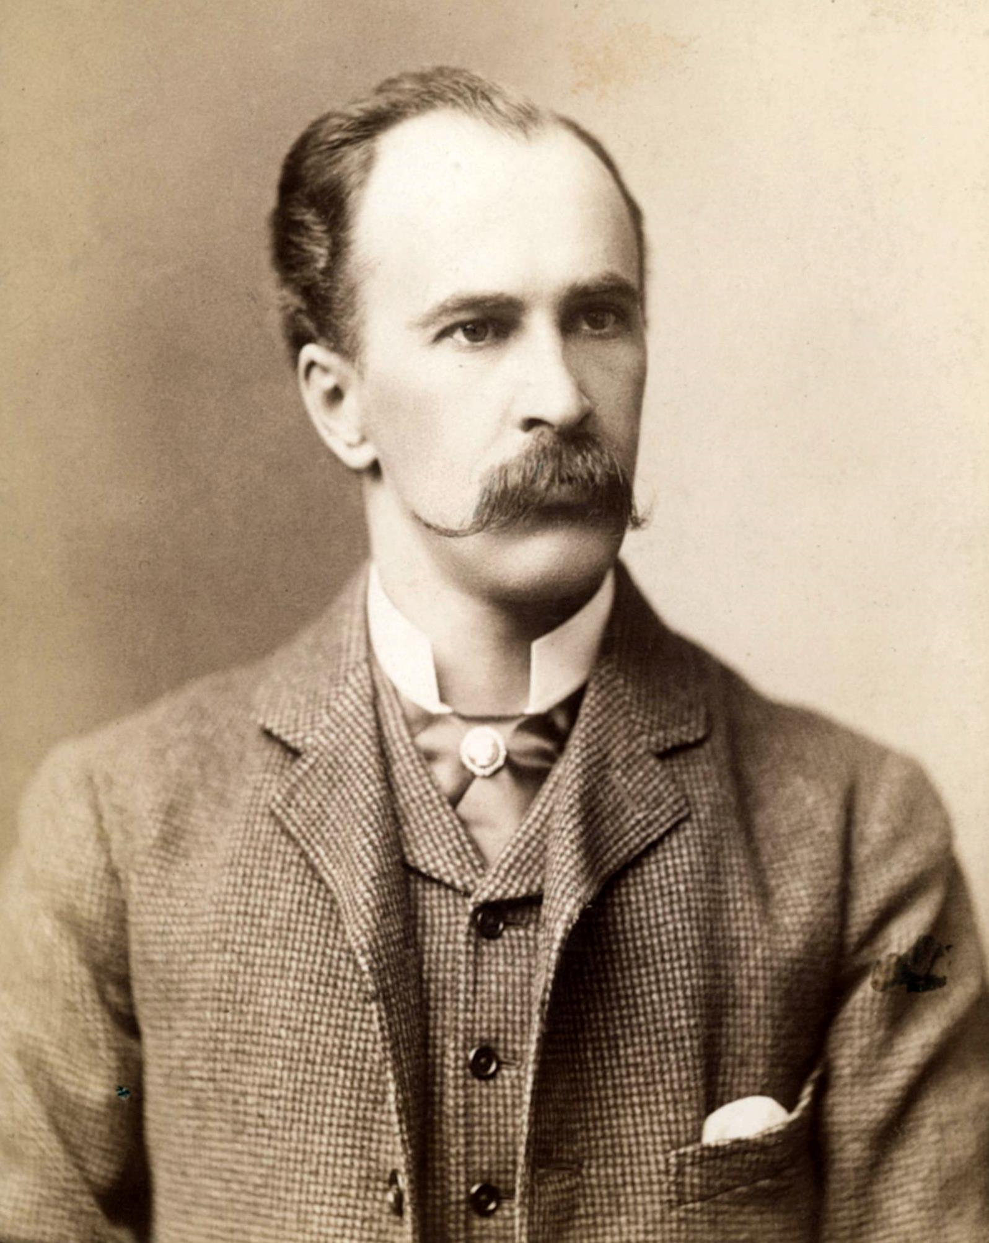
Results- Should compassion be part of a medical school curriculum?
The constant in medicine, in any service
Shifting a culture
Medicine is not exclusively diagnosis and curing illness, not just data analysis- an art just as much as a science
Notes:
-Results: Table with themes: left hand side put theme

Slide 40
“It is important for medical students to learn traits such as compassion and leadership- some have it inherently and the inborn confidence to deliver a message effectively and some don’t have it yet and need feedback.”
“Compassion is very important and an absolute necessary quality for all physicians to have.”

Slide 41
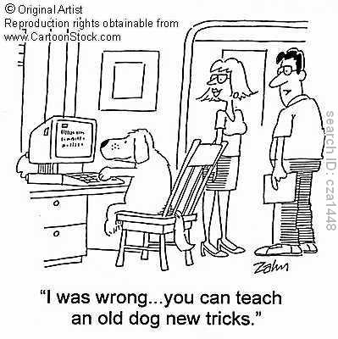
Results- Can you teach compassion?
“The Patient Experience”
Standardized Patients
Teach behaviors and gestures
Role Modeling
Self Reflection and Self Care
Leadership Training

Slide 42

“The Patient Experience”
  “We got to use the respirators. You could try to breathe on one if you wanted and see how uncomfortable that was for the patient. It made you really appreciate how you can try to make those settings perfect so that you could best breathe for the patient and that was a way to feel compassion with what they were going through.”
Notes:
Activities that simulate the patient experience
Examples
Radiology clerkship: ingest oral contrast
Respiratory course: breathe through respirators

Slide 43
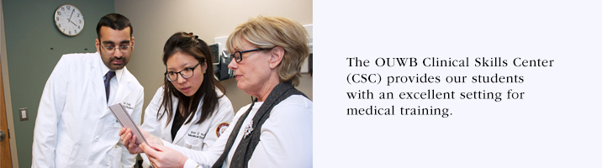
Standardized Patients
Difficult to teach compassion in a large setting
Simulated patient encounters provide immediate feedback to students after every session
A lot of people don’t know what they don’t know.
Questionable human variability- would testing be uniform?

Slide 44
“We don’t bring the video camera into real time situations, but we have actors come in. They can watch a video and say: ‘I had no idea that I spoke to nurses in that way’ or ‘I had no idea that I talked to a patient’s family that way’. These are things that they don’t perceive in themselves.”
“I felt this way when you were tapping your foot like that. Do you want your patients to feel this way or another way?”
“You need analysis of each individual students’ ability to communicate.”
Notes:
Sometimes you don’t know what you don’t know

Slide 45

The “Checklist” of Behaviors
Feeling vs. acting
Recognize actions of a compassionate person and turn it into something measurable
Teach behaviors and communication skills
  Entering room, soft knock and pause
  Language, tone of voice, proper introductions
  Eye contact, sitting at level of patient, avoid crossing arms, tapping feet
  Role reversal (empathy)
  Ensuring continuity of care
  Personal facts
  Summarizes, validates, anticipates next steps
  Silence for processing, time for speaking without interruption
Notes:
Are there actions associated with a compassionate person?

Slide 46
Even if people don’t necessarily feel what we would call “genuine” compassion, we can teach actions to make them feel comforted. Because at the end of the day the output is, how does the patient feel? Actions are what comes across to the patient. Focus on the patient’s anxiety. How do I relieve their stress and anxiety?
Notes:
Develop specific actions to make the patient view that their suffering has been eased.
There is a difference between a physician saying that he’s compassionate but this also has to be translated into your actions, which may not come across as compassionate. You can teach the actions.

Slide 47
Role Modeling
Baseline level of compassion
Learn skills through observation of faculty members and put struggling residents on teams with certain faculty members

Slide 48
“In the first 3 years of medical school between role modeling and education through OSCE’s and interacting with standardized patients, that when a student is exposed to a faculty member that isn’t portraying those qualities, they will learn from experiences and say that that is the complete opposite from what I was taught and that’s a quality that I don’t want to adopt. These first years are very important for instilling these qualities.”

Slide 49

Self Reflection
Go into your own experiences
Treat yourself well
Self awareness to focus on changing behaviors
Understand yourself and take advantage of inborn talent.
  Re-read personal statement and understand why you went into medicine
Notes:
Treat yourself well, as you would have others treat you, so that you are able to treat others well.

Slide 50
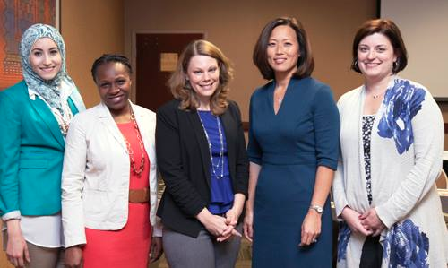
Leadership
Physicians as leaders of the health care team
Patient in vulnerable situation expects a plan
What are the qualities of a good leader?
  Feel present, engaged, specific plan of action, ability to motivate
  Communicating a plan and alleviating anxiety
Notes:
Relate to leader of a large company – alleviate anxiety in the masses vs. on an individual level in medicine

Slide 51
Results- Can compassion be measured?
Quantitative
Qualitative- “You can tell.”
Intuition
A “gestalt”
Direct feedback from SPs
Behaviors
Actions
Checklist

Slide 52

The many faces of compassion
A patient that comes from another country and does not speak English well

Slide 53
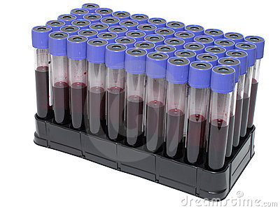
The many faces of compassion
The patient with terminal ovarian cancer who needed one last blood draw.

Slide 54
The many faces of compassion
Physician feels a mass on exam…

Slide 55

Discussion
Compassionate care increases success with patient compliance and improves patient outcomes
  Medical, psychological and sociological perspective
At the national level…
  Financial incentives to improve patient experience
    HCAHPS (Hospital Consumer Assessment of Healthcare Providers and Systems) Score
  Step 2 Clinical Skills Exam assesses the doctor-patient relationship
Notes:
Medical Perspective – the more comfortable a patient feels, the more the patient will disclose which will lead to a more precise history and a more accurate diagnosis.
Psychological Perspective – if the patient views the clinician as a trustworthy, protective figure, he will feel free to explore the meaning of illness, disclose real concerns without fear and experience a true connection with the physician
Sociological Perspective – when the patient views the physician as a helpful member of her social support system, she will benefit from the positive effects that system has on her physical, mental and social well-being.
A review of 21 published studies revealed that 76% reported a positive relationship between effective communication between physician and patient health
Effective communication included empathic engagement, supportive role, and concern about patients’ feelings and experiences (Stewart, 1996)
Physicians ability to communicate their concern, warmth, and interest to their patients also leads to patient satisfaction (Speedling and Rose, 1985)
Physicians’ empathic skills, interpersonal style, and willingness to answer questions have been cited as crucial factors in patients adherence to the treatment plan (DiMatteo, et al, 1993)
Physicians’ failure to understand the patient’s perspective was among the important factors that contributed to patient’s decision to sue (Beckman et al, 1994)
More than 80% of malpractice suits were based on unsatisfactory physician-patient relationships (Avery, 1985)

Slide 56
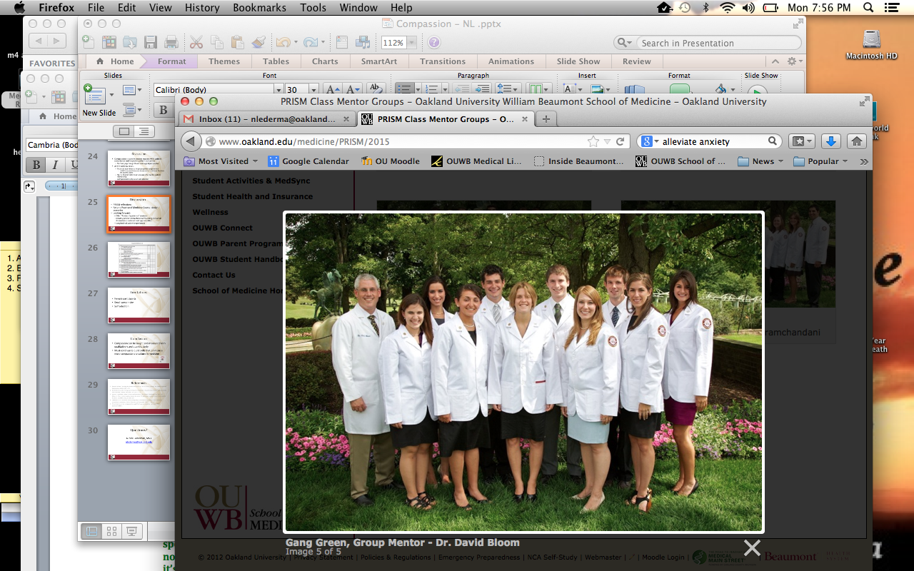
Discussion
PRISM reflections
Art and Practice of Medicine Course- design scenarios
Looking forward:
  Offer “Patient Experience” sessions
  Identify patient interactions surrounding end of life discussions as educational opportunities
  Longitudinal patient experiences
Notes:
What is an experience that a student could have that would better enable them to connect to the needs and concerns of the patient? Spend a day walking around in a hospital gown or attached to a bag of fluids.

Slide 57
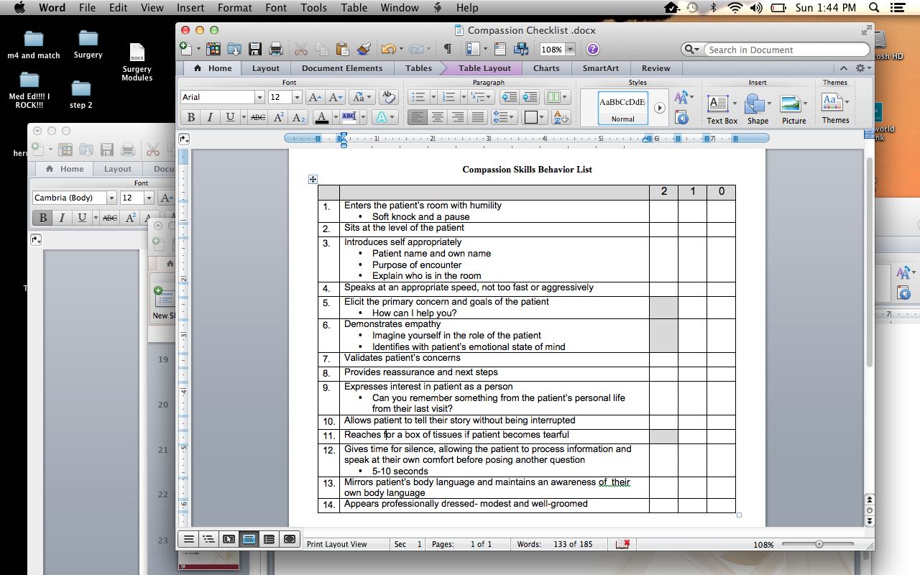

Slide 58
Limitations
Female participants
Small sample size
Self selection
Notes:
Goal was to recruit everyone but only female participants showed up, small sample size, not diverse sample (gender) with students and male SPs, self selection for focus participation and interviewing

Slide 59
Conclusion
Compassionate physicians are desired.
Compassion can be taught and measured both qualitatively and quantitatively.
Medical schools must continue to provide learning opportunities so that medical students can develop skills to provide compassionate care.
Notes:
Closing remarks

Slide 60
References
Branch, William. Teaching the Human Dimensions of Care in Clinical Settings. The Patient-Physician
Relationship. 286(9): 1067-1074.
Burks DJ, Kobus, AM. The legacy of altruism in health care: the promotion of empathy, prosociality
and humanism. Medical Education. 2012;46:317-325.
3. Haque, O and Waytz, Adam. 8 Ways to Help Patients Feel Human. Medscape.com. Sept 2012.
Moyer, C. What Factors Create a Humanistic Doctor? A Nationwide Survey of Fourth-Year Medical
Students. Acad Med. 2012;85:1800-1807.
4. Teherani A. Can simulations measure empathy? Considerations on how to asses behavioral
empathy via simulations. Patient Education and Counseling 2008; 71: 148-152.
5. Wear D, Zarconi, J. Can compassion be taught? Let’s ask our students. J gen Intern Med
2007;23(7):948-53.
11

Slide 61
Questions?
Nicole Lederman, MS3
nlederma@oakland.edu

Slide 62
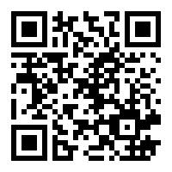
Reminder: Claim CME/MP Credits Online
https://www.surveymonkey.com/s/ouwb14
IMPORTANT ----- Credits must be claimed online by July 2, 2014;
after this time, CME credit will no longer be available.
CME Activity Code is Required to Claim Credits – See CME Handout
(Code varies based on viewing location)

Slide 63
Reminder: Claim CME/MP Credits Online
https://www.surveymonkey.com/s/ouwb14
IMPORTANT ----- Credits must be claimed online by July 2, 2014;
after this time, CME credit will no longer be available.
CME Activity Code is Required to Claim Credits – See CME Handout
(Code varies based on viewing location)

