Slide 1
Student Organization Adviser Training
September 17, 2015

Slide 2
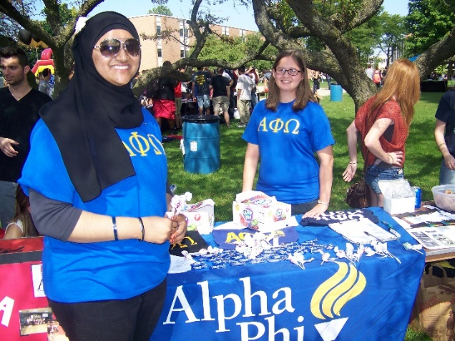
Training Schedule
Introductions
OUPD: Clery Act Video
The role of the adviser
Center for Student Activities
Campus Resources
Policies and expectations
Student Activities Funding Board (SAFB)
GrizzOrgs
Leadership and Volunteer Center

Slide 3
Oakland University Police Department
Clery & Campus Security Training
http://www.oakland.edu/?id=6665&sid=206

Slide 4
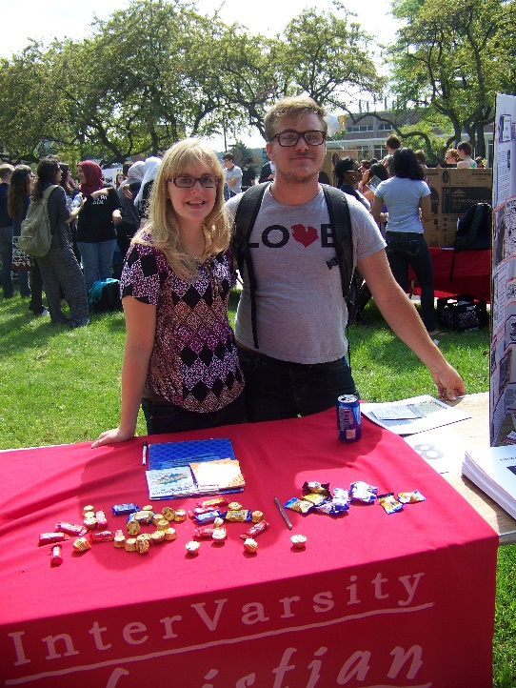
What is a student organization?
At least 4 students
4 officers- President, Vice President, Secretary, Treasurer
Adviser- OU Faculty or Staff Member
Registered on GrizzOrgs
Have attended a student organization training

Slide 5
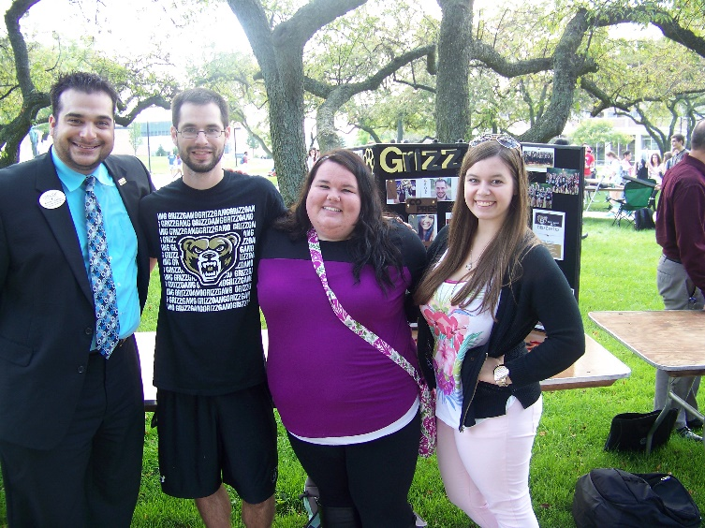
The Role of the Adviser
Roles to play:
Mediator
Motivator
Processor
Encourager
Communicator
Confronter
Teacher
Listener
Innovator
Ally
Diplomat
Challenger
Devil’s Advocate
Goal Setter
Roles to not play:
Nag
Guest Speaker
Titan
Warden
Preacher
Worry Wart
Critic
Manipulator
Boss
Parent
Follower
What role do you play?
Notes:
Hand out expectations checklist

Slide 6
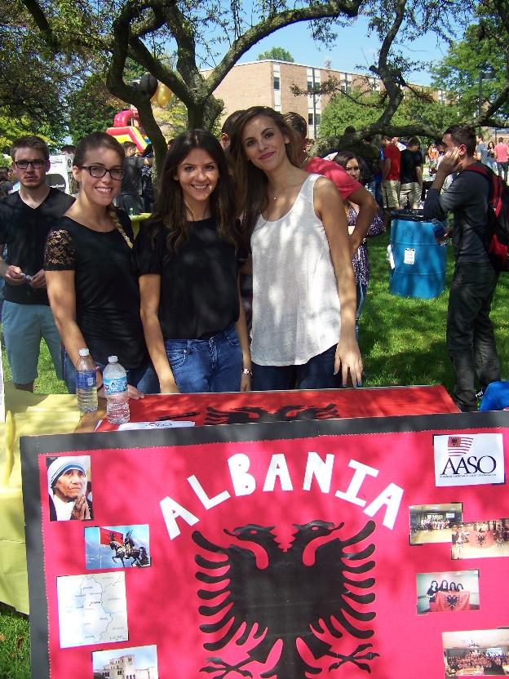
CSA’s Adviser Expectations
Be Human
Attend Trainings (you are here!)
Meet with your organization (don’t just be a name)
Do not advise more than 2 organizations
Discuss terms of the relationship
Help develop goals and provide suggestions
Make sure the organization is following proper procedures
Be present at large scale events
Make sure the students are not over-involved!
Have fun!
Notes:
(use the adviser's expectations checklist)

Slide 7
Center for Student Activities
Jean Ann Miller | Director, Center for Student Activities and Leadership Development
Allison Webster | Assistant Director of Student Organization Programs
Emily DeLano | Coordinator of Leadership and Service Learning
Grace Wojcik | Coordinator of the Gender and Sexuality Center
Demetrius Murchison | Accounting Clerk
Lori Marsh | Office Assistant
Ashley Trefney | Graduate Assistant for Student Organizations and Greek Life
Kara Leslie | Graduate Assistant for Leadership and Service Learning

Slide 8
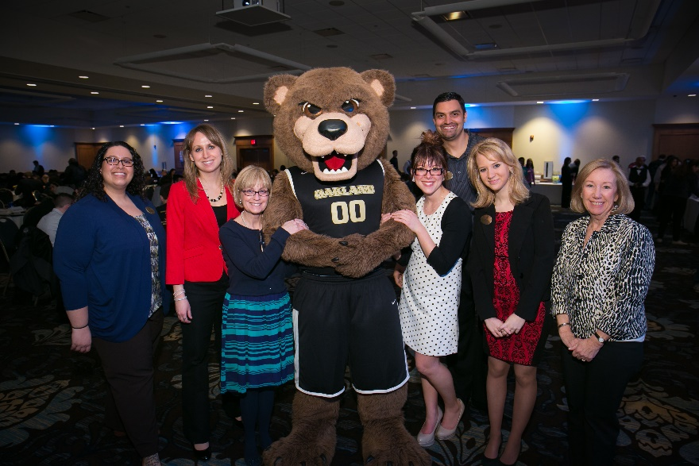
Center for Student Activities Resources
Printing and Faxing
Storage Space
Mailboxes
Banners
$15.00 charge per banner
Equipment
LCD, Laptops, Sound Systems, Canopy, Signs, Tables
Service Window
Deposits
Ticket Sales

Slide 9
The Oakland Center
User Groups
Group A
Recognized University groups including faculty and staff groups, all University departments, and registered student organizations associated directly with the University. FREE CHARGE
Group B
Recognized University groups that charge admission or registration fees, collect donations, generate funds in any manner, promote business products or services, or include event and or meeting participants primarily from off-campus but are related to University business. 50% Rate
Group C
Non-recognized groups (Group C) include all off-campus profit and non-profit organizations, groups, corporations, businesses, religious organizations, churches, clubs and individuals. 100% Rate
Decorations
NO: Stapling, tacking or adhering to any painted surfaces, brick walls, furniture, floors or glass doors. No glitter or confetti. No candles, pyrotechnics, fogging devices and decorations that "bleed" color
Groups that violate the decoration policies may be charged accordingly.
Materials Distribution
Distribution of material and solicitation of any kind are not permitted on OU's campus without prior approval
Posting Policy
All flyers and table tents must be approved by the CSA

Slide 10
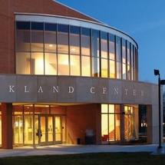
OC Reservations
Room/Table Reservations in the OC Form
All events will be booked on a first-come, first-served basis.
This form goes directly to the RESERVATIONS Office
Friday, October 23 is the first day to reserve rooms in the Oakland Center for the Winter 2016 semester.
Outdoor Events/Bonfire Request/Non-OC Room Reservations Form
This form goes to the CSA who coordinates with the appropriate offices (Registrar)

Slide 11
Chartwells Catering
With the exception of the University bookstore and vending machines all food and beverage sold or served in the Oakland Center must be provided by the Oakland Center in-house food service provider. Groups are not permitted to bring food or beverage into the Oakland Center. Violation of this policy may result in a suspension of facility scheduling privileges.
How do I contact and how do I place an order?
Visit 121A Oakland Center and ask for help
Go to Dineoncampus.com/Oakland
E-mail catering@Oakland.edu
Put together an order at www.chartwellsou.catertrax.com
This is NEW to create the option to build your own quote/order
Quotes must be signed and confirmed one week in advance from your event date.

Slide 12
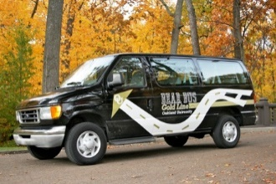
Bear Bus
You can rent the Bear Bus for your student organization!
Driver: $10/hour (minimum 1 hour)
Mileage: No Charge
Gas: Return vehicle with full tank of gas
Fill out the form at http://wwwp.oakland.edu/bearbus/ and submit within 14 days of desired usage.
Only trained Bear Bus drivers may operate the Bear Bus shuttles.
Shuttles may not be rented for overnight use, nor are they authorized to leave the State of Michigan. Shuttles may only be rented when not in use, and are available on a first come, first served basis.
Please contact bearbus@oakland.edu with further questions or inquiries.

Slide 13
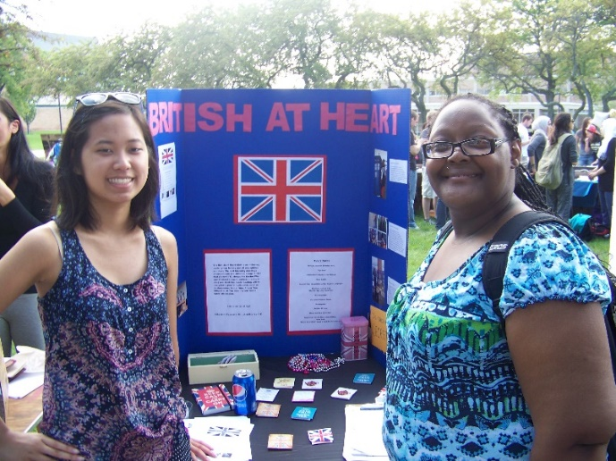
Student Organization Policies
Students may only serve as an officer of two organizations.
They should not hold the same position in more than one.
Organization Deficits
Statements in student organization mailboxes
Film Policy
Must purchase the rights
No Hazing Policy
Visit http://www.oakland.edu/csa for a full list of policies
Notes:
Decorations
No covering of windows or doors
Stapling, tacking or adhering to any painted surfaces, brick walls, furniture, floors or glass doors is prohibited.
No glitter, confetti, candles, fogging, decorations that “bleed” color
Materials Distribution
Distribution of material and solicitation of any kind are not permitted on OU's campus without prior approval. In the Oakland Center, on- and off-campus groups and individuals can promote their products or services only at reserved information tables. To reserve a table in the OC, you must contact the Oakland Center Reservations Office
Oakland Center
Must reserve rooms prior to the date
Posting Policy
University departments or organizations may post materials on any authorized bulletin board or display area.

Slide 14
Major Events
Major Events (dance, party, 100+ in attendance)
Need at least 10 members
Adviser must be present
Each student allows only one guest
The key to a successful major event= meet with CSA

Slide 15
SAFB
Student Activities Funding Board
If you would like to set up an appointment please feel free to email the SAFB Chair at: safb@oakland.edu.
Office: (248) 370-4292

Slide 16
Financial Policies I was approved for funding- now what?
Fill out the Petty Cash Request Form on GrizzOrgs. Take out the petty cash from the CSA, purchase your items, return the extra cash with the receipt to the CSA.
Have someone pay for the items, and then turn in the receipt with the Payment/Reimbursement form to get reimbursed
Make the purchases at Sam’s Club- but first have someone in your organization register for a Sam’s Club card via the Sam’s Club Card Registration Form.
Meet with Demetrius Murchison in the CSA, he can make the purchases on his credit card.
Have someone fill out the Payment/Reimbursement Form. You will also need to upload an invoice to get the items ordered.

Slide 17
Grizz Orgs
GrizzOrgs- http://www.oakland.edu/grizzorgs
Forms
Contracts
Travel (in state, out of state, out of country)

Slide 18
Leadership and
Volunteer Center

Slide 19
Leadership Exploration Series
Leading The Way With Customer Service - September 15th 4-5pm
Professionalism 101 - October 12th Noon-1pm
Financial Literacy For Leaders - October 26th 4-5pm
Your Online Tattoo: Social Media - November 19th Noon-1pm
TIPS Training - January 12th 4-5pm
Understanding Mental Health For Student Leaders - February 15th 4-5pm
Leadership Tips and Tricks for Young Professionals: Graduating, Now What? - March 14th 3-4pm

Slide 20
Leadership Consultants
Consultants present tailored workshops on numerous topics.
Topics offered - How to Make an Outstanding LinkedIn Account, Myers-Briggs Testing, True Colors Testing and more.
LCs are soft skill developers that can help students increase their soft skill competency, which employers highly desire.
Getting a LC to present at your meeting is FREE!

Slide 21
Seasons of Service
Volunteer Fair/Grizz Fest - September 10th - 11am - 2pm
Make A Difference Day - October 24th - 8am - 1pm
OU Day of Service - November 18th - 9am - 9pm
Mitten Tree - December 1st to 18th
MLK Day of Service - January 23rd 9am - 1pm

Slide 22
Emily DeLano
Leadership and Service Learning Coordinator
Office - Center for Student Activities (downstairs in the OC across from the computer lab)
Phone Number - (248) 370-4334
Email - delano@oakland.edu

Slide 23
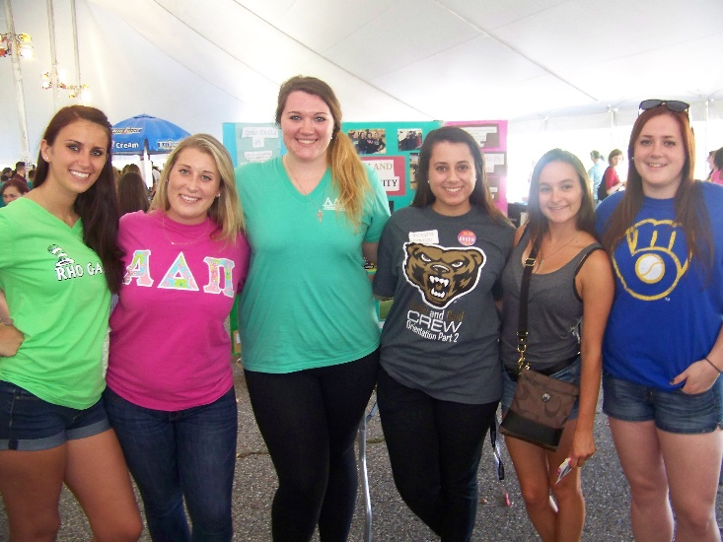
Thank You!
Any Questions?
Allison Webster: Webster@Oakland.edu

