Slide 1
See Something, Say Something, Do Something
Sexual Abuse Awareness

Slide 2
Overview
Defining Sexual Abuse
Characteristics of Offenders
Unacceptable Behaviors
Acceptable Behaviors
What To Do
How To Avoid
Notes:
Voiceover:
Defining Child Abuse
Recognizing sexual abuse: Unacceptable Behaviors
Recognizing sexual abuse: Acceptable Behaviors
What To Do If Abuse Is Occurring
How To Avoid sexual abuse
Characteristics of Sex Offenders

Slide 3
What is Sexual Abuse?
Defined
Unwanted sexual activity forced on a person by another
Notes:
Voiceover: Unwanted sexual activity forced on a person by another through coercion or threats.

Slide 4
Characteristics of Offenders
Offenders are not always strangers
Sex offenders are not easy to suspect.
Notes:
Voiceover:
They get to know the children and place themselves in settings that involve children. Many offenders specifically pace themselves to work with children; being teachers, coaches, pastors, etc.
Offenders are not easily identifiable. They are usually some of the nicest, most helpful people, to get on the good side of the child.

Slide 5
Characteristics of Offenders (cont.)
Offenders can be male or female
Offenders know their victims very well
Notes:
3. They can be male or female. They do not all look like monsters. They can be well groomed and dress nicely.
4. They typically know and have fantasized about their victims. They try to become a close and trusted adult by the child so they will not be afraid of them.

Slide 6
Recognizing Sexual Abuse: Unacceptable Behaviors
Examples
Sexually provocative comments
Risqué jokes
Intimate/ sexual content
Touching of breast, buttocks, or groin
Watching a person undress
Watching a person use the bathroom
Notes:
Voiceover:
-sexually provocative or degrading comments
-risqué jokes
-intimate/romantic/sexual content
-touching of breast, buttocks, or groin
-showing pornography or involving youth in pornographic activities
-watching a person undress or use the bathroom

Slide 7
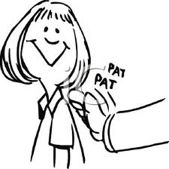
Recognizing Sexual Abuse: Acceptable Behaviors
Acceptable when done on occasion
Praise
Pats on the back or shoulders
Positive reinforcement for good work/behavior
Notes:
Voiceover:
There are behaviors that are acceptable as long as they are respectful and appropriate.
Touching should be in response to the need of the child, not then need of the adult.
Touching should be with the child’s permission.
Resistance to touching must be respected.
Touching should be done in the open, not in private
Touching should have a brief, limited duration
Examples of acceptable behaviors are: praise, pats on the back or shoulders, and positive reinforcement for good work/behavior

Slide 8
What Do You Do?
Report to a trusted adult IMMEDIATELY
Tell your parents
They will believe you
You will not be in trouble
Notes:
Voiceover: (read slide)

Slide 9
How to Avoid Sexual Abuse
Know the adults you can trust
Check with caregiver/adult before doing activities
Go places with friends instead of alone
Notes:
Voiceover:
Know the adults you can trust. Ask your parents who those adults are so you know who to turn to in an emergency.
Check with a caregiver/adult before doing activities
Go places with a group of friends instead of alone so you don’t put yourself in a vulnerable situation.

Slide 10
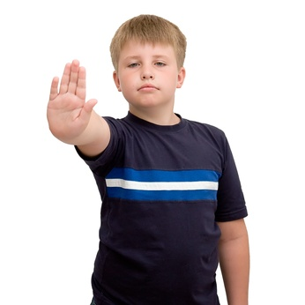
How To Avoid Sexual Abuse (cont.)
Know what is considered acceptable behavior
You can say “No” or “Stop” to anyone that threatens you sexually
Notes:
Voiceover:
Know acceptable behaviors: praise, pats on the back or shoulders, positive reinforcement for good work/behavior
You always have the power to say “NO” or “STOP” when you feel you are being sexually threatened

Slide 11
Review
Don’t forget “See Something, Say Something, Do Something”
The best protection and prevention against sexual abuse is awareness

Slide 12
Contact Information
Michigan Report Hotline
(800) 942-4357
OUPD
(248)-370- 3331
Non-OU Emergencies
911

