Slide 1
University Human Resources
December, 2011

Slide 2
What is it?
An assessment of your current skills
What do you already know?
An evaluation of where you need to go
Where are your gaps in knowledge?
Interactive, task based assessment
Not multiple choice, you will be performing tasks in the software environment
Basic, standard, and advanced assessment tools
Choose from Microsoft Office 2003, 2007 or 2010

Slide 3
Why Should You Take It?
Showcase your own skills and abilities to make you more competitive
Improve your skills to make your job easier
Personal goals to increase technology skills
VERY IMPORTANT – This is not a pass/fail test. No Internal applicant will be denied an interview based on this assessment.

Slide 4
Getting Started
Schedule an appointment by contacting Employment Services x to take a SkillCheck assessment.
You have up to 30 minutes to take each assessment and you will receive immediate feedback.
Notes:
Your handouts have contact information for Employment Services.
You will complete the assessment in a private setting, with minimal distractions. You will not need to bring anything to the session; not your G#, SOC#, nothing.
You have about 30 minutes for each assessment even though most of them do not take that long.
Supervisors are aware of assessment testing - and employees can take assessments for self-improvement or other job opportunities.
If an employee asks for time during work hours to take assessments - supervisors are asked to provide "reasonable accommodation" for employees to do so.
Sometimes an employee doesn't want to share with a supervisor their interest in perhaps applying for other positions so feel free to contact Employee Services on your own time also.

Slide 5
Taking the Assessments
How to get started?
The assessment will take you through a quick tutorial on what to expect
What are you being assessed on?
Its assessing you on the skills you currently have in the applications
Notes:
The tutorial will show you how to navigate and what questions looks like, how to answer, etc.
While you are taking the Excel 2010 assessment, it is giving you all types of questions from beginning to advanced so it knows how to assess your skill set
It also breaks outs accuracy by sub-category…they are different for Access, Excel and Word
Example: Word - sub-category: Editing - score could be 100% - accurate answers for 7 out of 7 questions, Formatting - score could be 83% - accurate answers for 10 out of 12 questions, Printing - score could be 60% - accurate answers for 3 out of 5 questions, etc., etc., etc.

Slide 6
Logging in and picking your assessment
Notes:
This is an older version of SkillCheck but I wanted to give you an idea of what to expect.
The assessment administration will help you get started so there’s no need to worry ☺
The system you would be using has 2010 included in it along with several other programs.

Slide 7
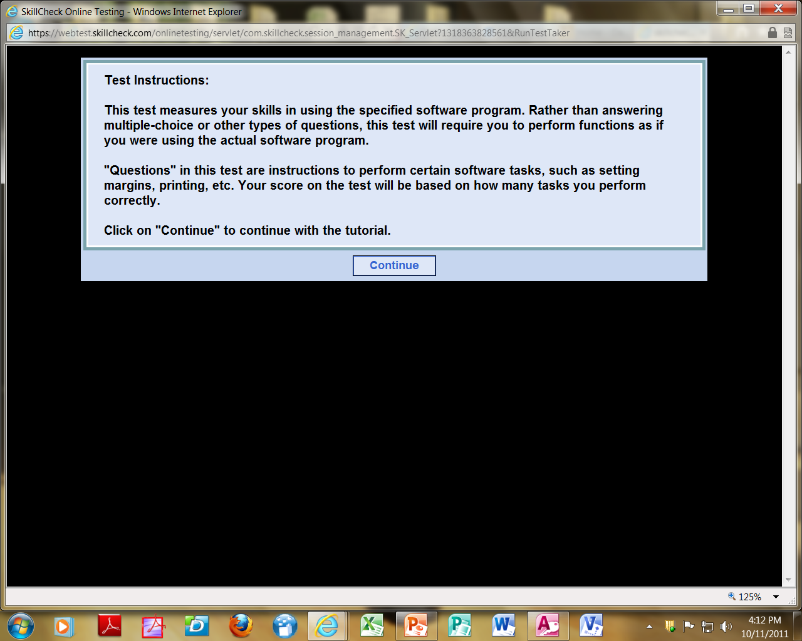
Notes:
Throughout the tutorial, you will be presented with information on what to expect while doing the assessment.
This screen is telling you that you will not be answering multiple choice questions but instead you will assessed on the actual functions you perform (as if you were really doing this any other time)

Slide 8
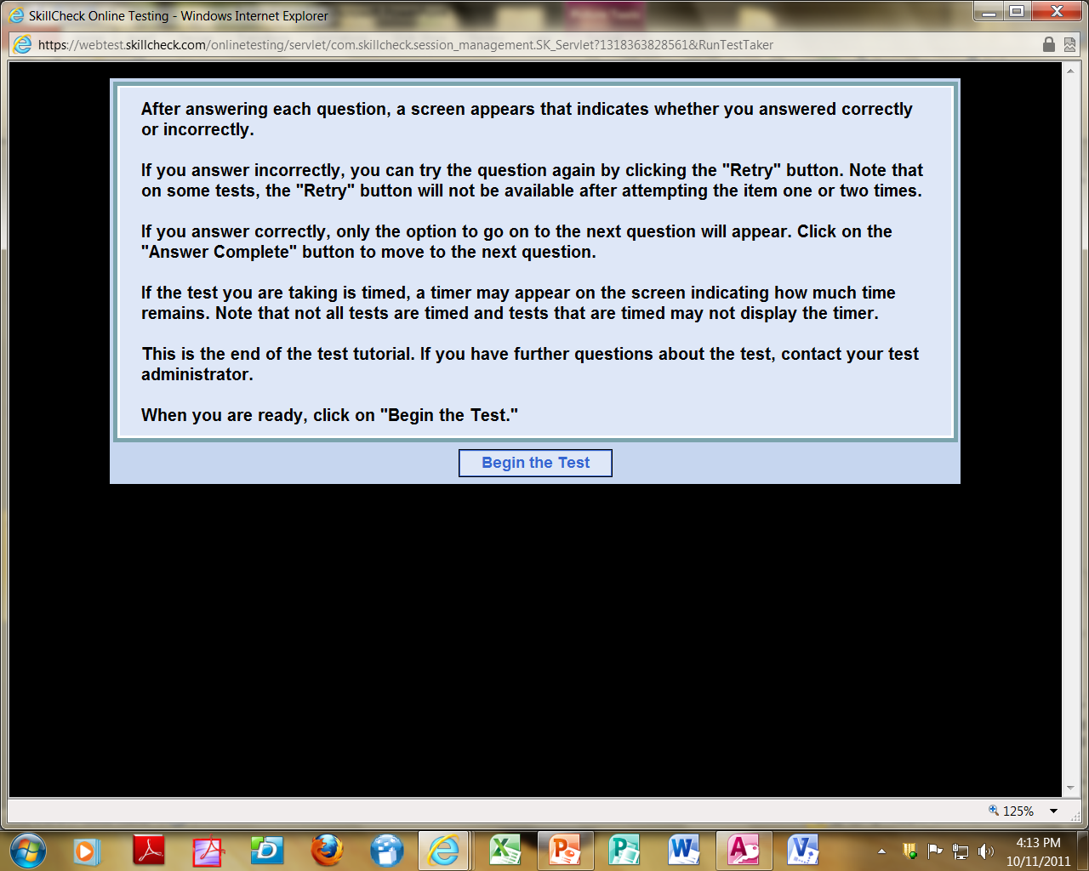
Notes:
After each question you will know if you answered “correctly”, “incorrectly” and you will also be allowed to “retry” the question.
Keep in mind, you only get 2 tries…..After 2 tries (if needed), you will simple click on the “answer complete” button and move on.
You will also be able to “skip the question”…..you can try it once and if you get it wrong, just go back to it later or…………..you can skip it all together and then have 2 attempts at it at the end of the assessment.
After answering a question, you may also be prompted to “try another method”, for example:
There are several ways to paste……you can use the home tab ribbon, right click menu or even a keyboard shortcut (CTRL V)…………..they are all correct but it wants to assess another skill or level of skill.

Slide 9
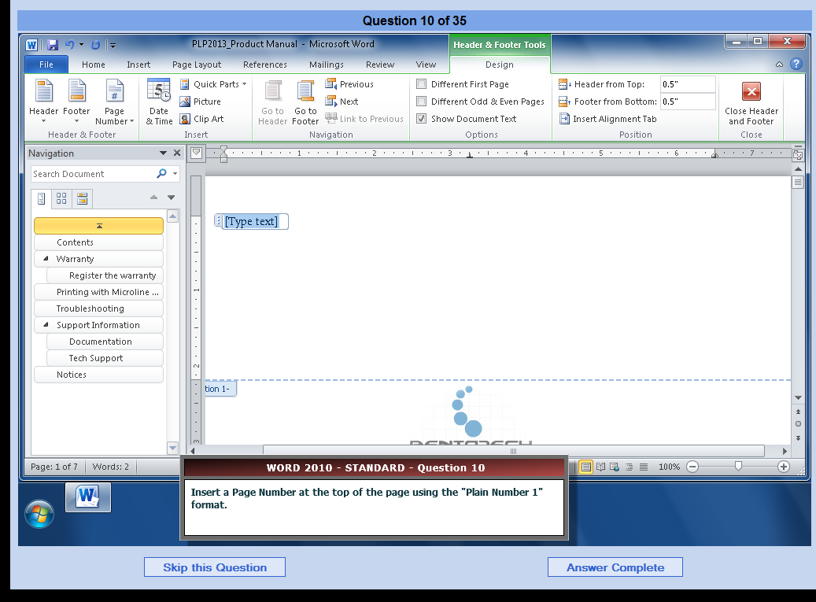
Notes:
I wanted to show you some examples from the software.
This is a particular question in WORD….Insert a page number at the top of the page using the Plain Number 1 format
You will notice that this particular question actually already starts you in the Header/Footer ribbon so there wasn’t a need to go to insert or even double click on the top of the page…..
Can anyone tell me what you need to do to complete this task?

Slide 10
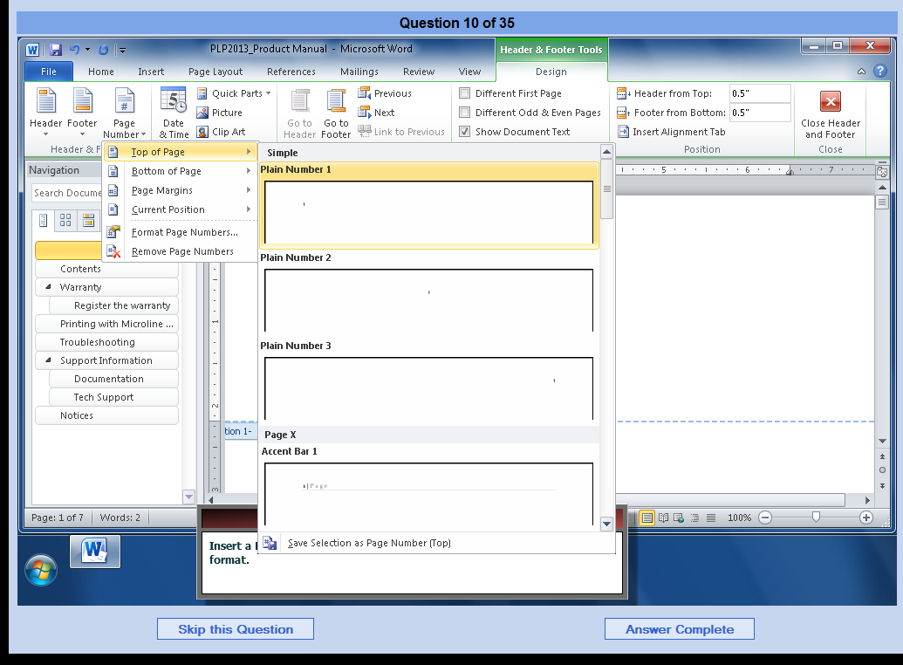
Notes:
What I did was,
Selected the Page Number option, then choose Plain #1 from the list and then click on Answer Complete

Slide 11
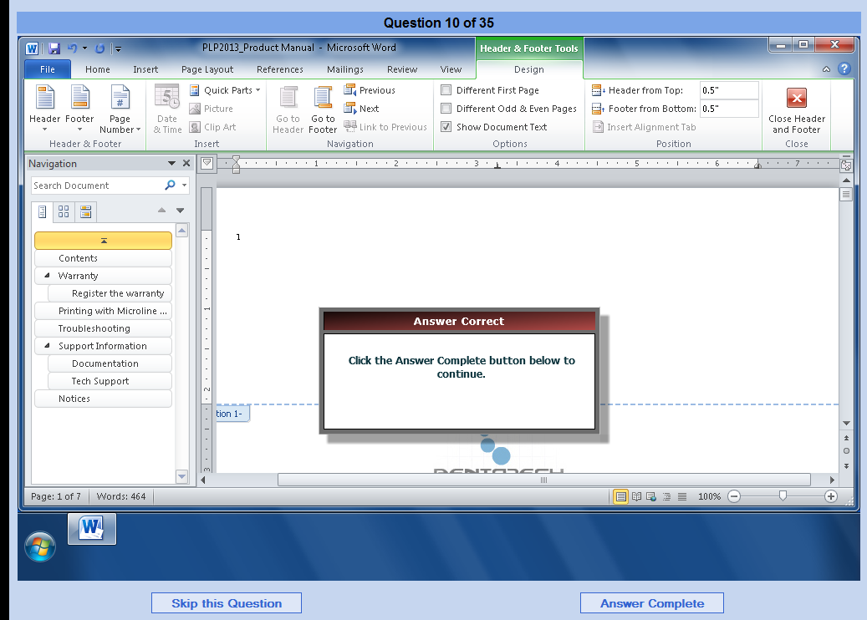
Notes:
If you get the question correct….this is what you will see.

Slide 12
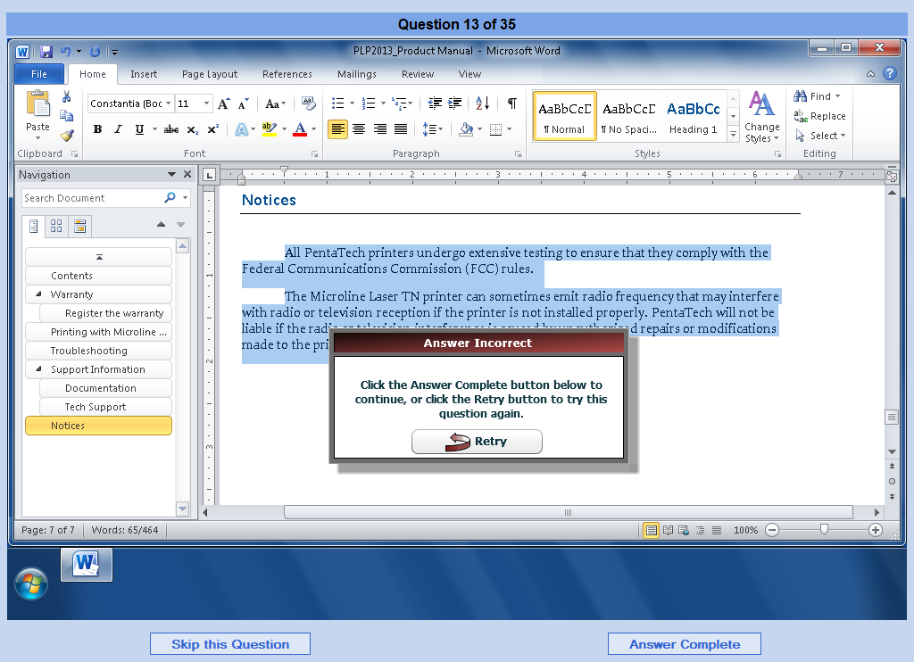
Notes:
Here is an example of what you would see if you got a question wrong……
You are given the opportunity to retry the question 1 time……I suggest everyone does this.
The question isn't wrong until you’ve answered it wrong twice!

Slide 13
Notes:
Another example………….Specify that text will wrap to the top and bottom of the graphic
What are they looking for? What does it expect you to do?

Slide 14
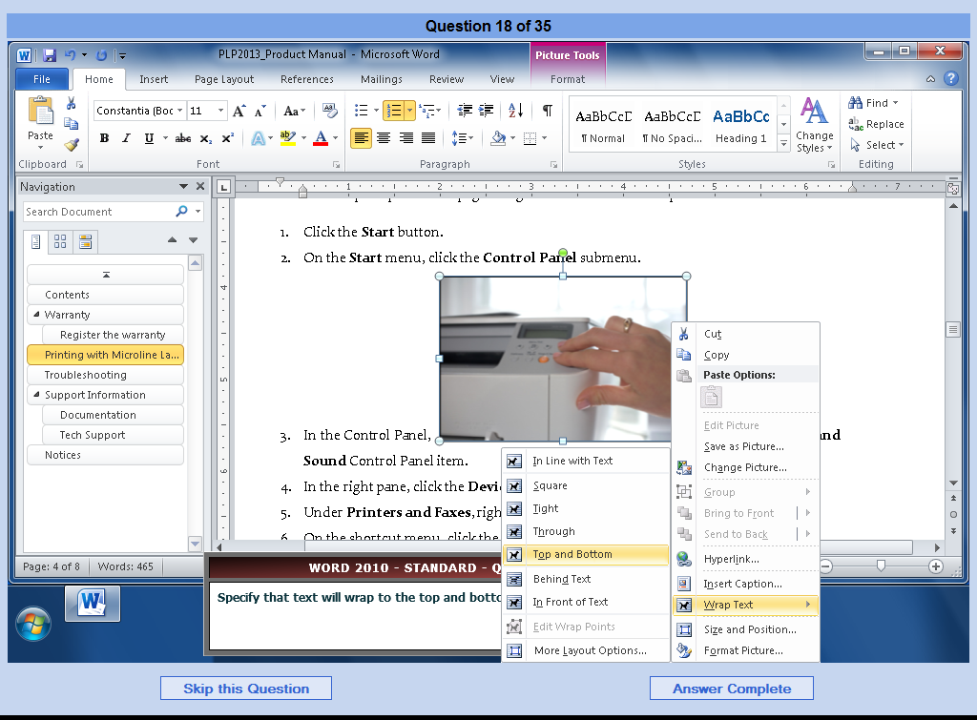
Notes:
I actually right clicked on the picture, selected Wrap Text and then selected Top and Bottom
Answer complete!
Now you could have clicked on the picture and then used the ribbon under “picture tools, format”
In this case I did exactly what it wanted me to do, but it could have asked me to “try another way” which I previously discussed

Slide 15
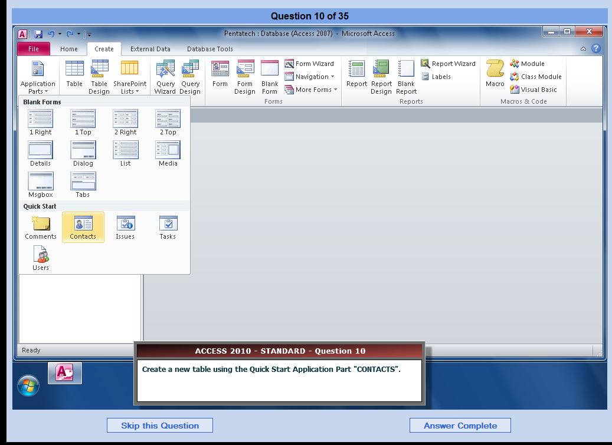
Notes:
Here is an example of a question you might get in Access….
All the applications in the SkillCheck look pretty much the same
Even though you are taking an assessment in SkillCheck, its literally as if you are sitting at your desk, working in your own documents
Its very user friendly ☺

Slide 16
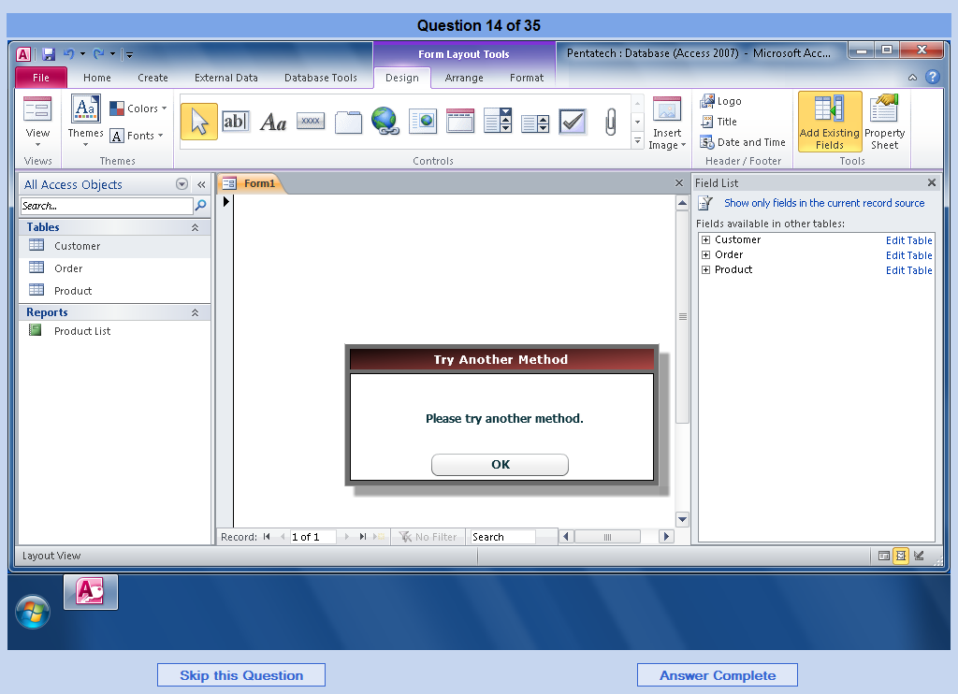
Notes:
Like I mentioned earlier, this is an example of what would pop up if they wanted you to “try another method”
Lets just say that you performed a step you thought was accurate BUT the system wanted something else……this is the message you would be given.
It wants to assess another skill level you may have….
You did not get it wrong and it is not counted against you, the assessment just wants to see whether you know how to do another way……it may want you to use a keyboard shortcut or just another way besides the one you used…it simply wants to access another skill level

Slide 17
Notes:
Once you have completed the test, you will get this message.
Yayyy!!! You are done! With this one ☺

Slide 18
What do your scores mean?
Notes:
You will be provided with results from the Employee Services administrator.
Scores will be different for everyone depending on your skill set.
(Go over the results) (These are from Access)
SkillCheck will give you a breakout by level: Beginning, Intermediate and Advanced and then the percentage you scored for each level.
The Productivity Analysis:
It’s a programmed response. If you don’t answer every question exactly the way the assessment wanted you to, its going to give you a lower productivity score.
Supervisors are asked to ignore this portion of the results page and focus more on the overall scores.
I am actually sending you all home with a copy of the most commonly used keyboard shortcuts for your own personal interest.

Slide 19
Notes:
These are the results on the sub-categories you will be given.

Slide 20
SkillSoft Comparison Document
Notes:
Now what do you do if your not happy with your results?
You can see the SkillSoft Comparison document to see which SkillSoft courses address the area(s) of weakness that you have identified.
You can access a copy of this document on the Employment Services Training page at http://www.oakland.edu/uhr/training/employment/.

Slide 21
Keyboard Shortcuts
Notes:
Remember earlier, I mentioned that the system may want you to “try another method”, Keyboard shortcuts may be what they are looking for you to know and do……
So it might be good to know at least some of the basic ones like Ctrl P for Print or Ctrl C for Copy instead of going through the functions in Word
Its simply just a way to perform functions more quickly ☺
You can access a copy of this document on the Employment Services Training page at http://www.oakland.edu/uhr/training/employment/.

