Slide 1
Opportunities to Empower Students Through General Education Curriculum
Cassandra Barragan MSW
Assessment Coordinator
Office of Institutional Research & Assessment (OIRA)

Slide 2
General Education Survey
1510 students were surveyed asking them about their Gen-Ed classes and their opinions of these classes and the program in general.
828 students surveyed identified themselves as entering Oakland University as a first-time college student
675 were transfer students.
119 teaching faculty & 18 academic advisers responded regarding their perception of challenges faced by students in regards to the General Education requirement.

Slide 3
“There should be more weight put on general education, more than half of a BA in my opinion. Trade schools can help people who only want to have a job or know about one thing. Universities should be about creating or honing the next generation of thinkers.”
Student comment

Slide 4
Comparing perception with actual university data
Why the differences?
Formal reasoning classes are MATH classes – possibly the highest rate of complaints!
In reality, the sheer number of classes in KE are much higher than FR.
Again, FR causes a great deal of distress for many students but NST includes Biology & chemistry – subjects that can be an academic struggle for students.

Slide 5
Dispelling the myths
General Education programs are a way for universities to generate income
Repeat of high school
Waste of time and money
Shouldn’t have to take classes that don’t relate to my major
Professors don’t care so why should I?

Slide 6
Some comparisons….
Students
Teaching Faculty
52% of students feel they are well prepared for upper level writing requirements
58% feel Gen Ed program does not prepare students to write at a college level

Slide 7
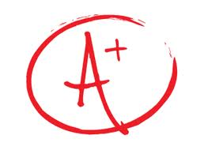
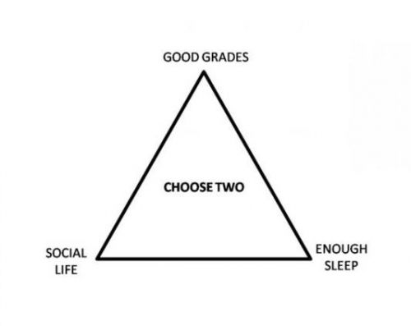
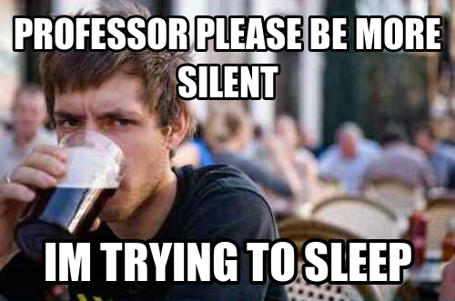
Students want….
Relate to their major
Foundation for career and upper level classes
Interaction with their professors
these things have also been found to contribute to student success!
Banking concept in teaching – does this work for Gen Ed?

Slide 9
Teaching for success!
Presenting the Material | Approaching the Class
Professional training | Learning to write is an ongoing process
Practical applications in all fields | You can take the student closer to the expectation
Relate to what the student knows | Taking students outside their comfort zone is part of the learning process
Encourage small group projects | Give opportunity to interact on a more personal level

