Slide 2
INFORMATION PRESENTATION
FOR
OAKLAND UNIVERSITY’S
PROGRAM IN PHYSICAL THERAPY

Slide 3
Undergraduate Preparation for Application to DPT

Slide 4
How applications are evaluated
Overall GPA
Science and Math GPA
Prerequisite GPA
GRE
Recommendation Letters
Experiences
Essay
Extracurricular activities
Awards
Honors

Slide 5
Grade Point Averages
Requirements
Overall GPA
Must be at least 3.0
Science and Math GPA
Must be at least 2.7
Prerequisite GPA
Must be at least 3.0
Averages for the Class of 2021
Overall GPA
Average of 3.67
Range 3.5-3.9
Science and Math GPA
Over 3.4

Slide 6
Prerequisite Coursework (subject to change)
Biology
Anatomy
Physiology
One Biology, Physiology or Anatomy Lab
Math through Pre-calculus
Intro to Stats or Research Design
Chemistry: 2 semesters
One Chemistry Lab
Physics: 2 semesters
One Physics Lab
Exercise Physiology
Psychology
Introductory
Developmental
Must earn a C or higher in all prerequisite courses

Slide 7
Optional Additional Coursework
Students can complete an equivalent human pathology course prior to entry into the professional program which will reduce credits in the DPT, but does not impact acceptance if not taken.
If you would like to take this course at OU as a guest student or post bachelor student, you can email dptadmissions@oakland.edu for further information.

Slide 8
Graduate Records Examination
Must have at least V:144, Q:147 to be eligible for the program
Official scores MUST be submitted to PTCAS using the Oakland/PTCAS code of 0650
Can retake; highest score from any attempt used in evaluation of application
Complete test by mid-July if you want to apply early
Suggested completion by September 15 to meet final deadline

Slide 9
Recommendation Letters
Two letters required
One MUST be from PT
Other can be from variety of sources
Professor, employer supervisor, teaching assistant, physical therapy assistant…
Should be able to address potential to be a PT or a graduate student
Submitted electronically through PTCAS

Slide 10
Physical Therapy Experiences
Can include:
Observations
Volunteer
Employment
Recommend exposure to at least three different clinical practice settings and a variety of locations
Orthopedics, geriatrics, acute care, rehabilitation, school settings, industrial, skilled nursing care, neurological…
No required hours nor PT signatures (subject to change)

Slide 11
PTCAS Essay
Essay is evaluated on:
content
ability to fully address the question
format
writing mechanics

Slide 12
Strong Candidate (Class of 2021)
Overall grade point: approximately 3.7
(range 3.5–3.9)
GPA in science and math over 3.4
GRE scores: average V:152, Q:152, AW:4
Must have at least V:144 and Q:147
Strong letters of recommendation
PT experiences in 3 or more settings
Involved in university activities
Demonstrates an understanding of the professional behaviors needed to be a PT
Demonstrates an understanding of the depth and breadth of the profession

Slide 13
Program Information
PTCAS Directory Page (opening in May 2020)
OU’s Doctor of Physical Therapy Web Page
https://oakland.edu/shs/human-movement/physical-therapy-doctorate/

Slide 14
The Application Process

Slide 15
Application Process
One application
Application submitted through the Physical Therapist Centralized Application Service (PTCAS). The application can be found at www.PTCAS.org.
Access will open on June 17
Submissions begin on July 1
Deadline dates
Early Assurance Deadline: August 17
Final Application Deadline: October 15

Slide 16
Rolling Admissions
Oakland will be using a rolling admissions process.
All applications must be completed and submitted by October 15, 2020.
Verified applications will be reviewed by the admissions committee as they are received.
All applicants who meet the eligibility requirements for the program will receive a decision response no later than December 10, 2020.

Slide 17
Early Assurance
If an applicant submits a fully completed application by
August 17, 2020 and meets the following criteria, they will receive an early assurance decision response by September 20, 2020.
Overall GPA: at least 3.5
Science/Math GPA: at least 3.4
Verbal GRE: 150 or greater
Quantitative GRE: 150 or greater

Slide 18
Questions unique to OU
The Essential Functions Guidelines of the PT Program consist of the minimal physical, cognitive and behavioral abilities required for the successful completion of the DPT program. Please review the Essential Functions Guidelines to determine if you meet the required minimal abilities. Please indicate whether you have read the Essential Functions Guidelines.

Slide 19
Questions unique to OU
What steps have you taken to explore Oakland University’s Physical Therapy Program?
If you were accepted to more than one physical therapy program, what factors would you consider in choosing Oakland University?

Slide 20
Physical Therapy Program

Slide 21
What are the backgrounds of the faculty?
Internationally and nationally recognized
Active in profession
Majority continue to do clinical work
Several with Orthopedic Manual PT education
APTA-recognized specialists
Orthopedic
Neurological
Cardiopulmonary
Geriatrics
Pediatrics

Slide 22
What are the characteristics of students that attend OU?
Involved in profession
MPTA and Eastern District events
National and State Student Conclave
Developed Graduate Physical Therapy Association
Act as mentors
Involved in scholarship
Involved in service learning, community service
and professional service
Like to have fun
Intramurals
Class activities
Social gatherings

Slide 23
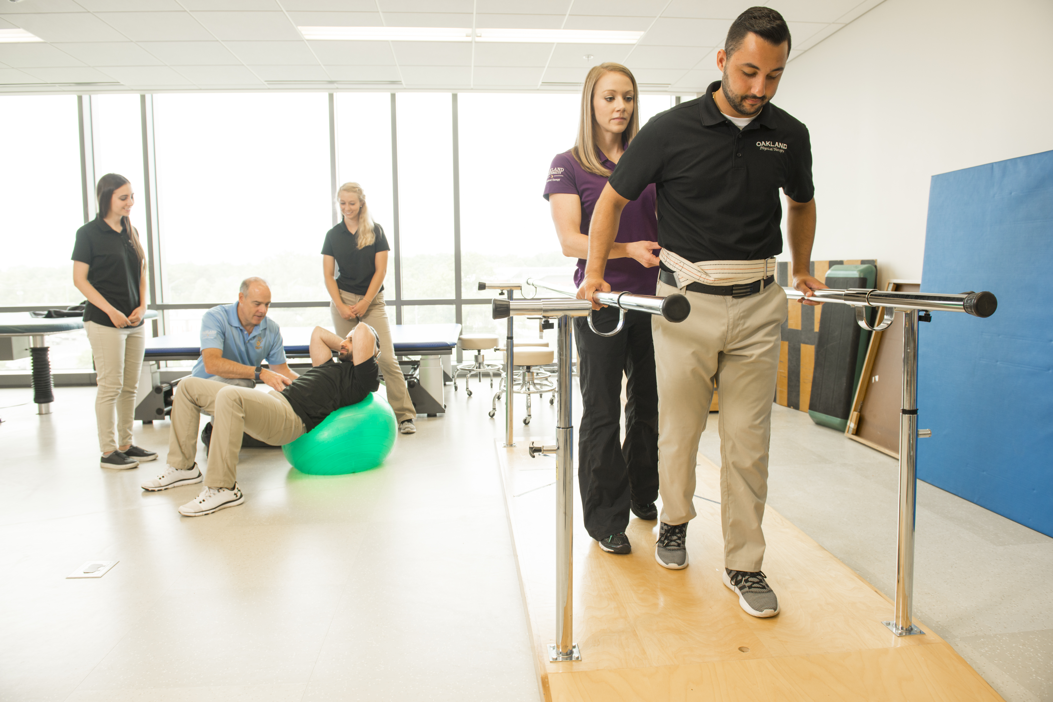
What are the strengths of OU’s DPT program?
Graduate competent to work in all areas
Involvement in scholarship and contribute to profession
Exposure to learning experiences
Cadaver dissection
Simulated patients and labs
Clinical visits and experiences incorporated within curriculum
Faculty

Slide 24
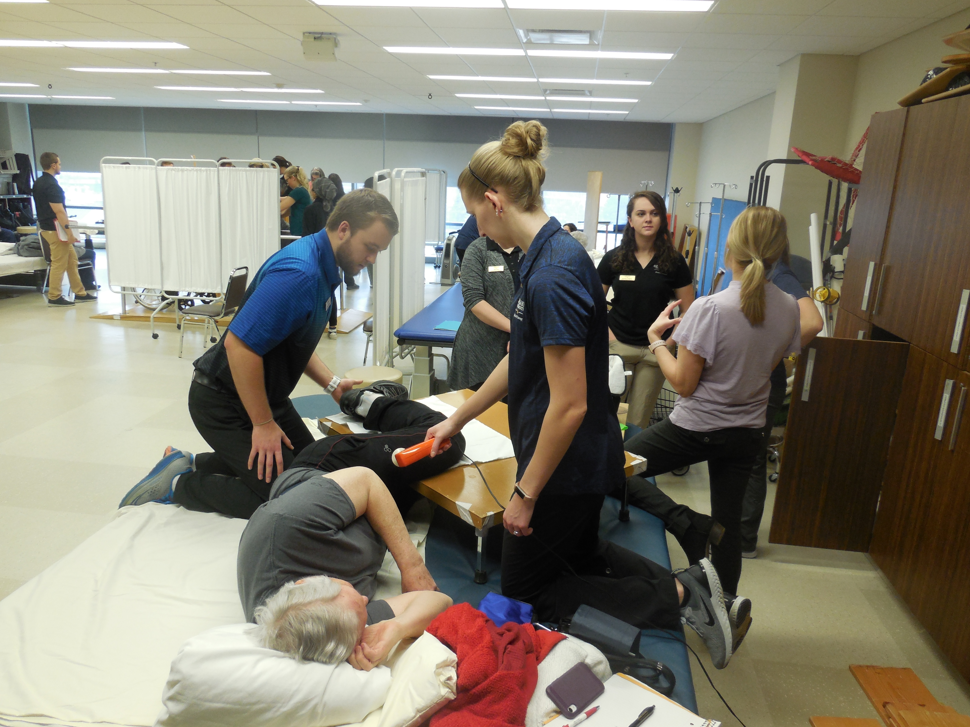
How does OU prepare students for the clinical setting?
Simulated patients
Clinical visits
Bridge the Gap
Clinical education experiences

Slide 25
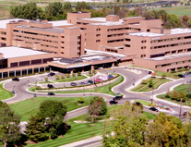
Where do students go on clinicals?
Student choose clinical sites from variety of settings
To date, students have stayed local if they choose to for all clinical education
First two clinical education experiences must be in the state
For last two 12-week clinical educational experiences, students may go to a site outside of the state, but this must be set up and coordinated early

Slide 26
What is the curriculum schedule?
Students attend fall, winter and May/June
Remainder of summer off
All exams also follow OU’s schedule

Slide 27
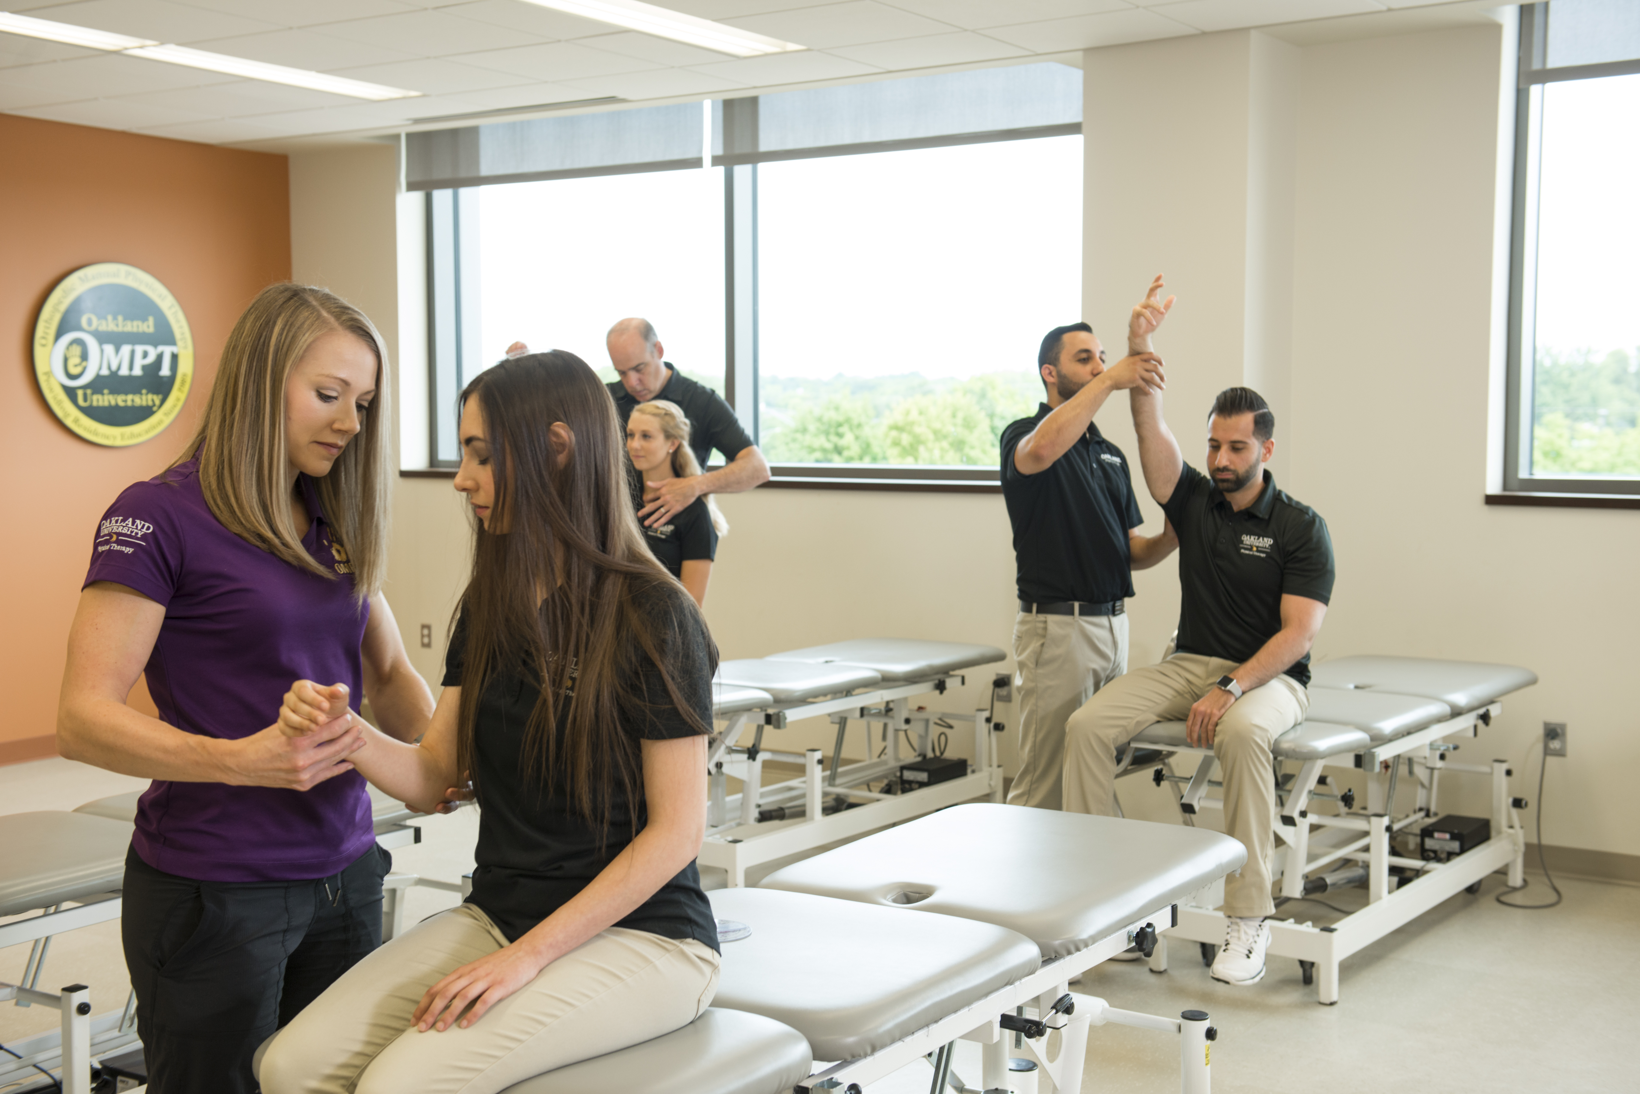
How are labs set up?
One lab session for entire class
Student/Instructor ratio
Equipment
Open labs sessions scheduled
Facilities open 7 a.m. - 9 p.m.

Slide 28
Is participation in research a requirement for graduation?
Collaborate with faculty’s research interests
Present research study at Research Day
Research manuscript

Slide 29
How does the faculty help students prepare for licensing exam?
Most faculty have been item writers or item reviewers for license exam
Some questions written similar to licensing exam
Comprehensive exam after each year
Capstone exam at end of curriculum
On-site review course
Licensing pass rate (three year average)
Ultimate pass rate - 98%
First time pass rate - 95%

Slide 30
What current students say about why you should come to OU?
“Professors are awesome”
“Faculty are very helpful and encouraging”
“Time off in summer”
“Good area to live”
“It’s affordable”
“It’s FUN”
“Come to OU for a caring experience
where your class and teachers
feel like a family”

Slide 31
What do graduates of the program say about why you should come to OU?
“Great education in all areas of PT – not just orthopedics, but neurology, acute care and cardiopulmonary”
“Got me ready for all aspects of care”
“If you want to do hands-on PT, OU is the place to go”

Slide 32
Frequently Asked Questions
What happens if I retake a class?
Both grades will be entered into PTCAS and will be averaged into the GPA calculations
Is a Pass/Fail grade accepted for prerequisite requirements?
Typically, pass/fail grades are not accepted for any courses
However, in response to COVID-19, we prefer applicants to achieve an actual grade for all prerequisite courses
Having a pass/fail grade will not prevent an application from being reviewed
In response to COVID-19, the GRE General Test at home option will be accepted

Slide 33
Contact: dptadmissions@oakland.edu

