Slide 1
Creating an Effective Syllabus
Judith Ableser Ph.D
Center for Excellence in Teaching and Learning
Oakland University
ableser@oakland.edu

Slide 2
Share your Syllabus
At your tables, if you brought a sample syllabus please share and discuss it. If you did not bring one, discuss what you plan to include in your syllabus.

Slide 3
Agenda
Welcome
Share your syllabus
Agenda
Learning Outcomes
The Syllabus-
Transforming Constructive Alignment into your Syllabus
What to include
Sample Templates
Sample #1- Basic Template
Example
Sample #2- General Education Template
Sample #3- Another sample
Review Templates
Revising your Syllabi
Wrap-Up

Slide 4
Learning Outcomes
Participants will be able to:
Describe the purpose of a syllabus
List the elements included in effective syllabi
Align the syllabus with learning outcomes and assignments that assess the learning outcomes
Review sample syllabus templates
Review sample syllabi
Begin to design or revise syllabi for winter

Slide 5
The Syllabus
Your syllabus is your contract with your students
Clearly states student learning and behavioral expectations and responsibilities throughout the semester.
It should be given and reviewed during the first class.
Changes should not be made once the semester starts (except in special circumstances).

Slide 6
Syllabus Checklist
1. First Page Contact Information
Oakland University
College or School
Department
Course Number- note as of fall 2017 will be using 4 digit code- should include both old and new code for a few years
Title of Course
Semester/year
Number of Credits
Name of Professor
Contact Number
Email contact
Office
Office Hours
Day/Time of in-class sessions
Class location

Slide 7
Syllabus Checklist continued
2. Course Description- directly from catalog
3. Prerequisites- if any (or co-requisites)
4. Learning Outcomes- observable, measurable outcomes that will be directly assessed
If a General Ed. Course- include L.O. and Cross Cutting Capacities
5. Required Text
6. Course Format
7. Overview of Assignments- titles, % of course, due dates
8. Grading
9. Grading Scale

Slide 8
Syllabus Checklist continued
10. Class Policies/Student Expectations
Academic conduct
Add/Drop
Disability Support Services/Accommodations
Moodle policies (if blended or on-line)
Additional policies that you want your students to adhere to
11. Course Outline- dates, topics, readings, assignments
due
Detailed Descriptions of Assignments with
Rubrics/Marking schemes (included in syllabus or
separate.

Slide 9
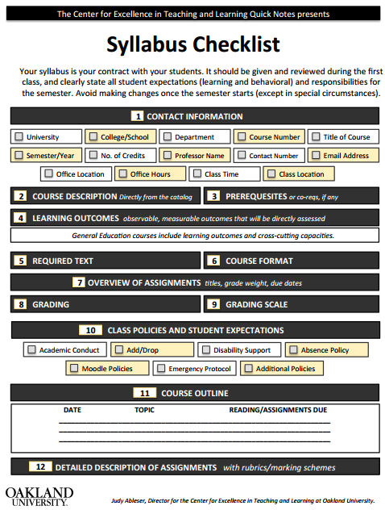
Syllabus Checklist – Quick Note

Slide 10
Constructive Alignment
Rationale
What drives the curriculum
Objectives
Curriculum content
Input- intended
Learning Outcomes
Assessment
Implementation
Professional standards, scope and sequence of program
Tasks that instructor and students do
Demonstrated evidence of what students learn
Observable, measurable, outcomes
Instruction, lessons, readings, assignments, activities that are linked directly to objectives/outcomes
Ways in which you measure the learning outcomes through assignments and activities
Observable, measurable, outcomes

Slide 11
When writing Learning Outcomes
Observable Behaviors (cannot observe “knowing”)
Measurable
Knowledge, skills and professional behaviors/dispositions
Relevant, meaningful, purposeful
Demonstrated Evidence of Behavior
THE STUDENT WILL BE ABLE TO…..
(TSWBAT….)

Slide 12
Examples
Poor: SWBAT learn/know about ….
Good: SWBAT….list
outline
define
debate
demonstrate
explain

Slide 13
General Education- Learning Outcomes
The phrase “learning outcomes” describe what Oakland University expects students to know or be able to do after receiving instruction or engaging in a learning activity. The new general education program has three major parts: foundations, exploration and integration. Within these main divisions there are ten knowledge areas plus diversity and a capstone. There are two learning outcomes for each. The number of general education outcomes (2) that a course must cover has intentionally been kept small since it is expected instructors will also want to include additional course-specific learning outcomes.

Slide 14
L.O.-Foundations of Knowledge
Formal Reasoning
The student will demonstrate:
Knowledge of one or more formal reasoning systems such as computer programming, mathematics, statistics, linguistics or logic
Application of formal reasoning to read, understand, model and solve problems across a variety of applications
Writing
The student will demonstrate:
Knowledge of the elements, writing processes, and organizing strategies for creating analytical and expository prose
Effective rhetorical strategies appropriate to the topic, audience, context and purpose

Slide 15
Sample Templates
You will find three sample templates that you can use to help you revise/design your syllabus
Included in with your hand-out is a sample completed syllabus

Slide 16
Review Samples
Review and discuss which aspects of these syllabi you prefer

Slide 17
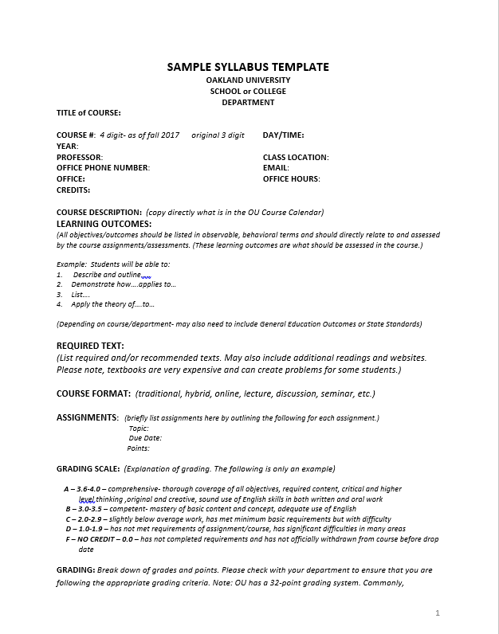
Sample Syllabus Template, page 1

Slide 18
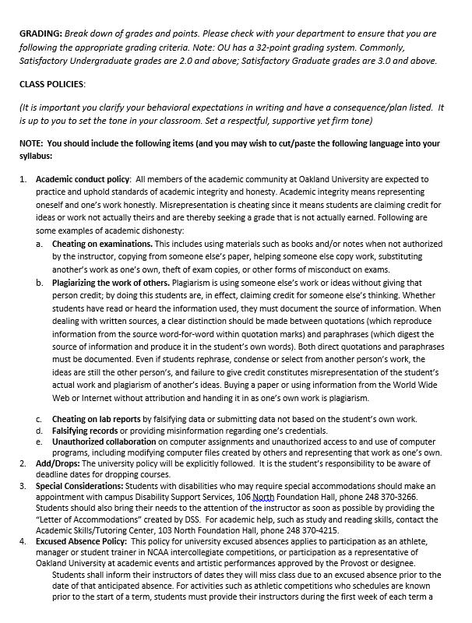
Sample Syllabus Template, page 2

Slide 19
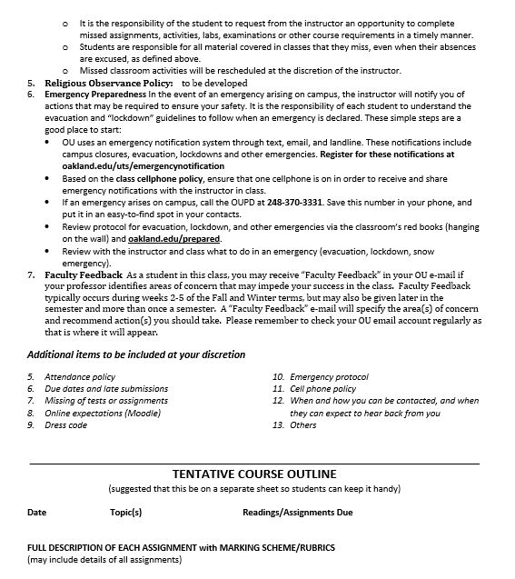
Sample Syllabus Template, page 3

Slide 20
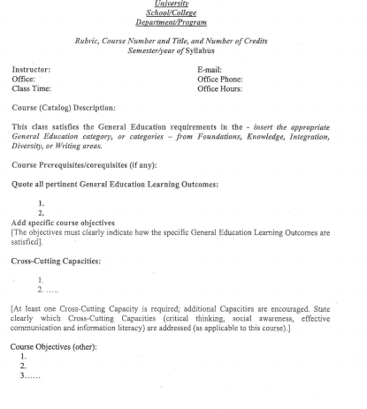
Sample Syllabus Template v2, page 1

Slide 21
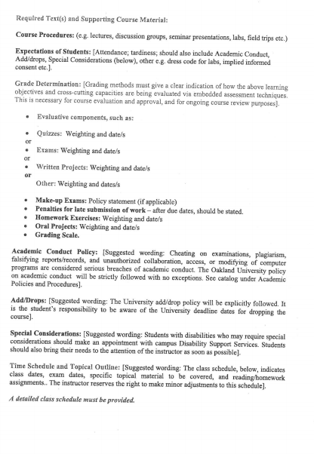
Sample Syllabus Template v2, page 2

Slide 22
Professional Development Syllabus Format
Course Title: Please provide name of course
Number of Credits: Please indicate number of credits
Instructor: Indicate your name and contact information (telephone and email), as well as the best way to reach you and the best times. Once you are in the OU email system, please use your OU email account. Students MUST also have and use their OU email account.
NOTE: If you are teaching a fully-online course, it is recommended that you NOT include your email on your syllabus. By not including your email, this will encourage students to go through Moodle to contact you, which has many advantages including letting you know to which course the student belongs, tracking conversations in one place, and others.
Here is a link to our webpage showing bios of faculty and instructors in our program. http://www.oakland.edu/ASD/SEfaculty. If your bio is not included here, please send information to martino@oakland.edu and we will add you to this webpage to your syllabus for students to view.
Semester and Year: Indicate which semester and year this course is being offered. Please be sure to update this as needed.
Format/Dates: Specify whether the course meets on-ground, online or in hybrid format.
If on-ground, give all face-to-face meeting dates and times.

Slide 23
Professional Development Syllabus Format cont.
If hybrid, indicate on which dates the class will meet face-to-face, AND on whether or not there are any other synchronous time expectations.
If online, indicate whether or not students will be required to participate in any Skype sessions, synchronous chats, or any other “real time” activity, and give specific dates and times these will occur.
Office Hours: Please indicate whether you will be available before or after each class, on a specific day/time, whether that time will be online, in person or by phone, the location, phone number or OU email to use, or whether you’d be prefer students contact you to schedule an appointment.
Please also include a statement about expected “turn-around time” related to responding to emails and voicemails – especially as it relates to time-sensitive issues (we recommend aiming for no more than 48 hours) – as well as how long students should expect it to take to receive feedback on assignments.
Pre-Requisites for this course, if any: Please see pre-requisite info below and include only that which applies to your course:

Slide 24
Professional Development Syllabus Format cont.
Textbooks/Readings (both required and optional): Please list them here.
Course description: At minimum, please give the Graduate Catalog course description for your course – if available – and feel free to add additional information as appropriate.
Here is a link to the Graduate Catalog (you may find your graduate course description here and include it in your syllabus): http://www.oakland.edu/?id=94828&sid=174
Topics: List all major topics included in the course description, as well as the supplemental topics that round out your course.
Learning Goals/Course Objectives: Use bulleted points to indicate what the students are expected to learn in this course.
Course Requirements/Methods of Instruction: What kinds of activities/assignments will be required? Will students work individually? In groups? Will they be required to do field assignments?
Methods of Evaluation/Performance Assessments: All methods of assessment, including exams, should include a practical component. The syllabus should clearly show weighting of assignments, either through points or a percentage of total grade. For the Oakland University suggested numeric grading scale, see p. 14 of the Practical Guide for Lecturers.
Biography/ References: These resources may be included under Textbooks/Reading if you prefer.

Slide 25
Professional Development Syllabus Format cont.
Please copy and paste the following statements to the end of your syllabus.
Academic Conduct Regulations: All members of the Oakland University academic community are expected to practice and uphold standards of academic integrity and honesty, including avoidance of plagiarism. All academic misconduct allegations are forwarded to the Dean of Students Office and adhere to the student judicial system. Academic Conduct Regulations can be found at http://www.oakland.edu/?id=1610&sid=75
Disability Support Services:
Students with a disability who feel they need accommodations should contact the instructor directly. If more formal supports are needed, persons with disabilities may contact Disability Support Services at www.oakland.edu/dss/.

Slide 26
Professional Development Syllabus Format cont.
Notice of Non-Discrimination:
Oakland University, as an equal opportunity institution, is committed to compliance with all federal and state laws prohibiting discrimination. Oakland University prohibits discrimination on the basis of race, sex, color, religion, national origin or ancestry, age, height, weight, familial status, marital status, disability, creed, sexual orientation, veteran status and other prohibited factors in employment, admissions, educational programs and activities. Inquiries or complaints should be addressed to: Director, Office of University Diversity and Compliance, 203 Wilson Hall, 2200 North Squirrel Road, Oakland University, Rochester, Michigan 48309-4401.
Technical Requirements for online or hybrid courses:
OU uses Moodle (http://moodle.org) as its learning management system. For those unsure about online learning, OU provides an online orientation to e-learning, information about Moodle and a self-assessment to determine if e-learning, information about Moodle and a self-assessment to determine if e-learning is for you. For more information on e-learning at OU, go to http://www2.oakland.edu/elis/.
Technically, you will need to download & use the Firefox browser, available free of charge at https://www.mozilla.org/en-US/firefox/. Firefox will maximize your e-learning experience. Lastly, high speed internet connections are recommended.

Slide 27
Design or Revise Syllabus
Use this time to begin to design or revise your syllabus

Slide 28
Q & A
Discussion

Slide 29
Wrap-Up
Did we
Describe the purpose of a syllabus
List the elements included in effective syllabi
Align the syllabus with learning outcomes and assignments that assess the learning outcomes
Review sample syllabus templates
Review sample syllabi
Begin to design or revise syllabi

